Slide 1
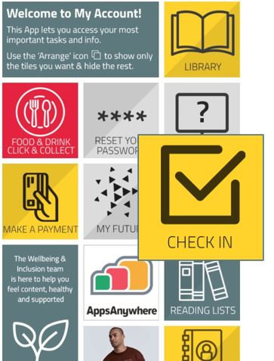
Check in to class
You should check in, using the unique code provided by the academic, to confirm attendance at any timetabled learning event taking place on campus, at one of our other teaching venues or online.
Check in via the Edinburgh Napier app or by visiting myaccount.napier.ac.uk – its quick and easy to do.
For more detail go to My Napier at my.napier.ac.uk/your-studies/check-in-to-class. You’ll also find a video there that shows you how to check in.

Slide 2
Student engagement reporting
Student engagement reporting has been developed to support student engagement and wellbeing.
The report looks at whether you have used various systems, including check in, Moodle, library loans and Resource Booker.
If you haven’t used any of the systems for two weeks or more a member of staff, usually your Personal Development Tutor, will get in touch to check everything is OK and offer support if you need it.
Everyone struggles sometimes so please reach out if you need support.
For more detail go to My Napier at my.napier.ac.uk/your-studies/student-engagement-reporting

