Slide 1
iPoint: High level vision
‘deliver an excellent personalised student experience’.
Vision: To provide a welcoming, accessible, highly visible and highly available ‘on campus’ and ‘virtual’ Information, Advice and Support (IAS) service for all.

Slide 2
iPoint: High-Level Objectives
To create an efficient and effective frontline support service for the University community that is visible and accessible 24/7/365
To bring a coherence to this Information, Advice and Support (IAS) mechanism branded as iPoint through establishing a multidisciplinary cross departmental team
To locate this multi-functional team, operating from a help desk (call centre) and from designated IAS ‘iPoints’, at primary entrances to the main campus buildings in a fluid, integrated and well defined service
To use technology and environment (iPoints) to enable IAS to deliver a ‘great’ customer experience and to facilitate a range of user needs and journey’s leveraging online information and knowledge

Slide 3


iPoint: Logos & Branding

Slide 4
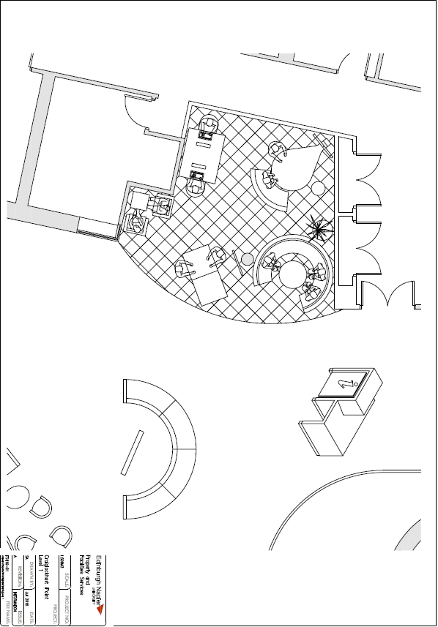
Craiglockhart iPoint

Slide 5
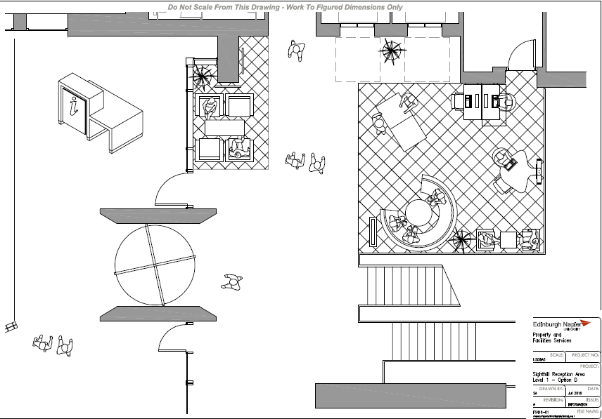
Sighthill iPoint

Slide 6
iPoint Furniture

