Slide 1
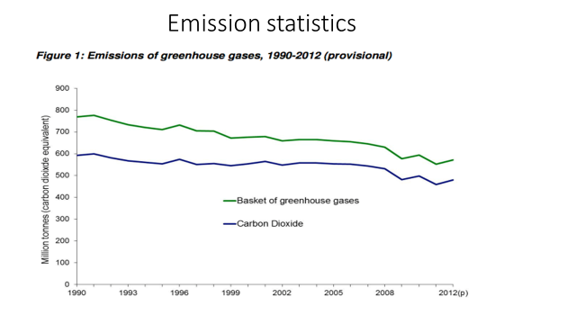
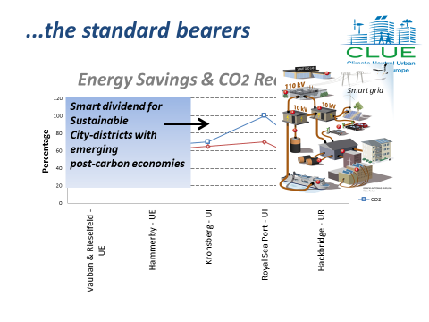
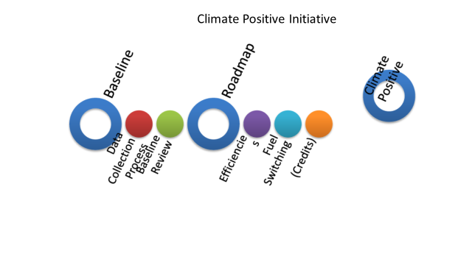
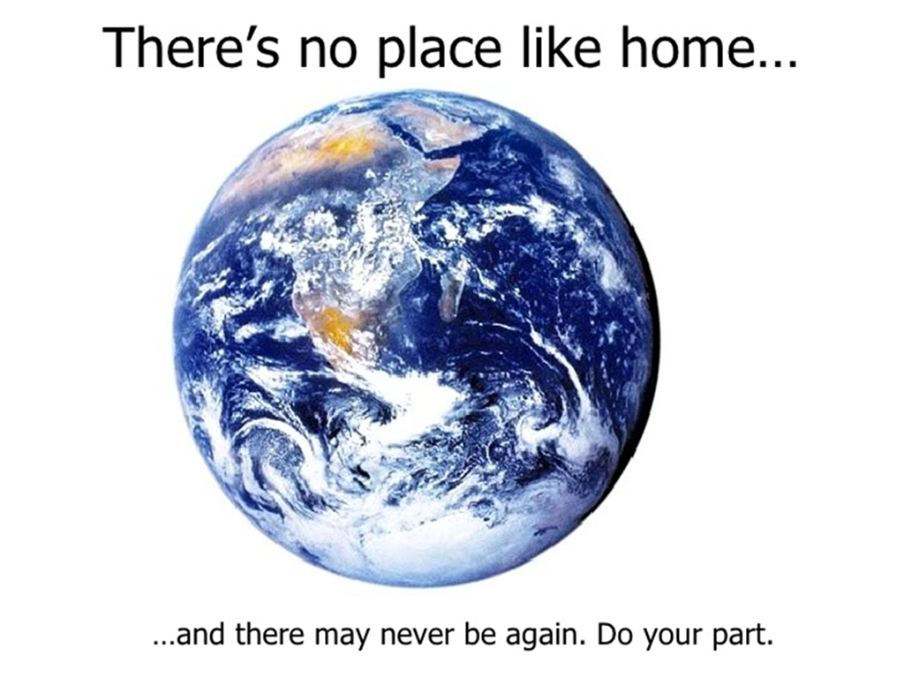
Oye Toyosi
Edinburgh Napier University
T.oye2@napier.ac.uk
Climate Change
Climate change been the most pressing issues facing the world today. The concept of climate neutral urban districts is a way to approach the issue of carbon emissions by creating test beds where new ideas and technologies can be introduced
Ignoring climate change is not an option
Time available is severely limited
No single solution to this issue
CLUE
CLUE illustrates the use of innovative and “smart” planning, participation and building concepts, new technologies and methodological approaches in order to reduce the urban carbon footprint to “zero” and at the same time considerably reduce energy and resource use i.e. making a city or an urban district “climate neutral”
CLIMATE NEUTRALITY
The concept of Climate neutrality aims to develop strategies and actions that avoid global climate change by elimination of the carbon emissions
At present, no there are no climate neutral cities in the world
Then, how do we achieve climate neutral in urban district?
CLUE Project
These projects are the standard-bearers of, and are leading pioneers that produces high-energy savings and emission reductions. Indeed, they are so advanced as to offer the prospect of a smart dividend for sustainable city-districts and include (neighbourhood) communities whose energy efficiencies pave the way for what are termed post-carbon economies.
Measuring Urban Sustainability
One of the main questions facing sustainable urban districts and cities is: how do we recognize progress towards sustainability? As more and more districts adopt sustainability as a goal, indicators can help to determine what direction should be taken to address the issue as it makes districts more visible and transparent, aid in comparison, evaluation and prediction.
The framework focuses on low energy consumption, local on-site energy production, a high share of renewables and community impact for low carbon emissions measures
Metabolism of City-Districts
This involves conceptualizing a city or a district as an organism and tracking resources that go into the system, products, and wastes that leave it as it provides a platform through which to consider urban sustainability implications.
Save the world
Conclusion
CLUE has provided a practical example of how climate neutral cities can be affordable, appealing and realistically achieved, at present, in an existing urban environment.

