Slide 1
2013 Employee Engagement Survey
Executive Summary
6 December 2013

Slide 2
Background
Timeframe: 4 November through 18 Nov
Participation Rate:
1273 respondents
72% response rate (assuming 1765 eligible participants)
Demographic Data Collected:
Role
Gender
School / Service
Faculty

Slide 3
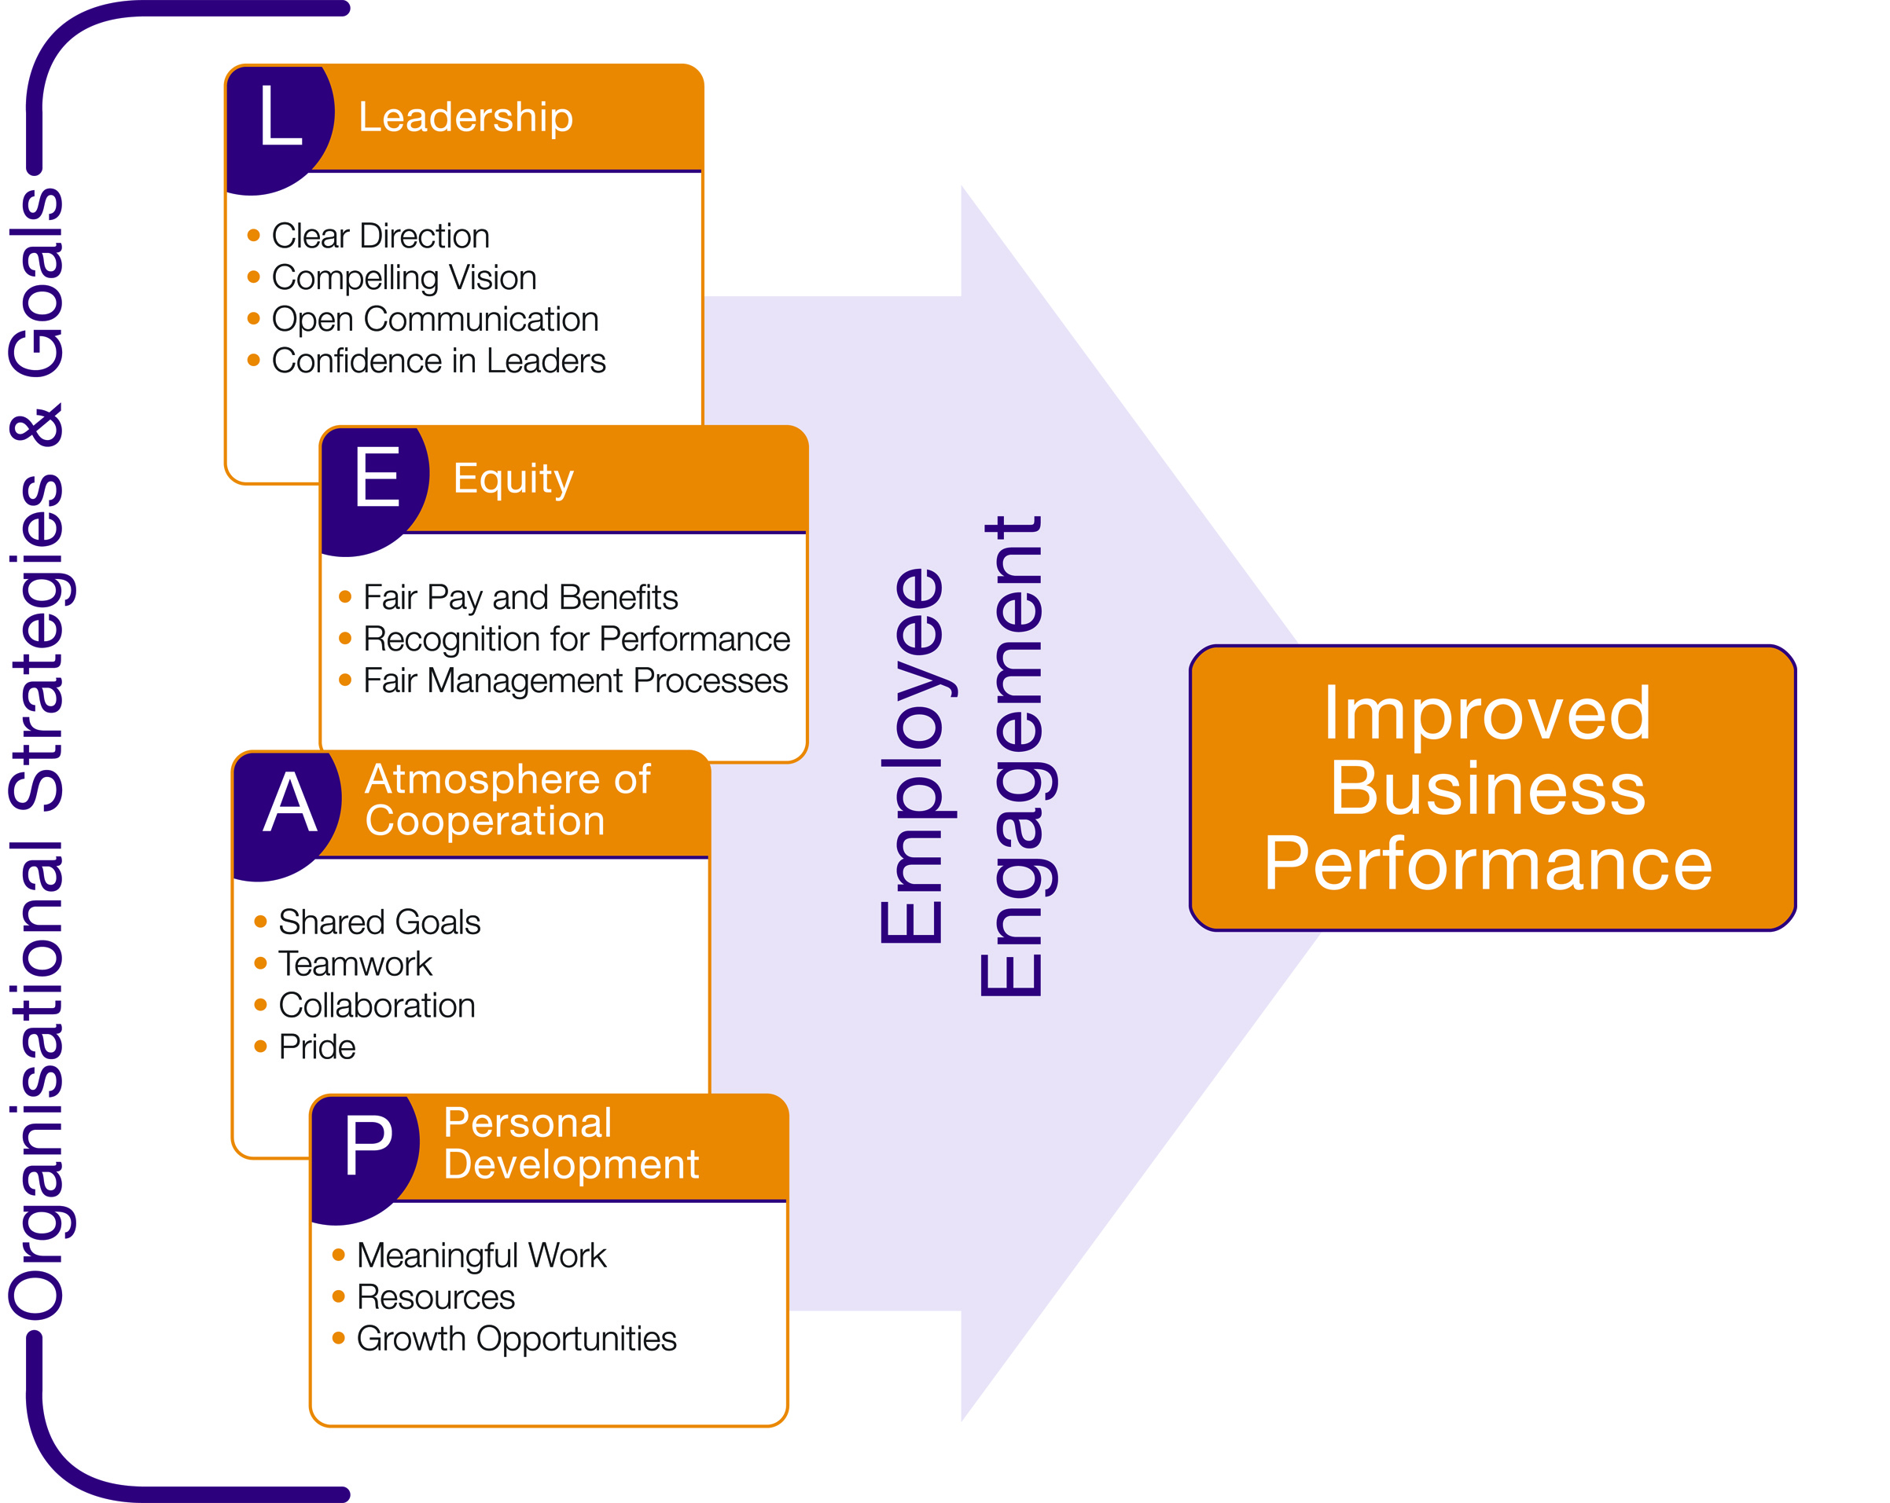
Background
Questionnaire:
52 core questions
15 supplemental questions on Overall Employee Engagement
Two open-ended questions
Themes:

Slide 4
Background
Questionnaire:
No data is reported for groups with fewer than 10 respondents
Data Presentation:
Questions were answered on a five-point response scale with the midpoint being neutral.
The two favourable responses are combined and the two unfavourable responses are combined to produce a simplified three-response presentation (positive, neutral, and negative).
Key dimension scores are the average of the question responses that make up the dimension.

Slide 5
General Benchmarks for Interpreting Survey Items
Clear Strength > 65% Positive
Moderate Strength 50 – 65% Positive
Opportunity for Improvement < 50% Positive
Weakness > 25% Negative
Clear Problem > 40% Negative

Slide 6
Major Themes
Overall Engagement
Engagement has increased across all areas since 2011
This reverses the trend seen in 2011, when engagement decreased over the previous year
Faculty
Largest gains seen in Health, Life and Social Science, and Business School
This reverses 2011 trend, and puts each Faculty at equal engagement levels
Notes:
Leadership – 39% vs 54%

Slide 7
Major Themes - continued
Role
Positive perceptions increased in virtually all areas across all roles
Overall engagement is approximately equal across roles, with exception of Senior Management which is higher
Gender
Mirroring other demographics, positive perceptions increased in all areas for each gender
Engagement levels are approximately equal across genders

Slide 8
Major Themes - continued
School/Service
Due to small sample sizes, each School/Service should be examined individually for specific trends

Slide 9
Overall Satisfaction
Increased 7% from 2011 to 66% favourable
Reversing 2011 trends, opinions about immediate work environment improved
Immediate manager (66% fav)
The job itself (66% fav)
Significant improvement on opinions related to University environment
Willingness to “recommend University as place to work” increased by 10% to 61% favourable
Intent to stay with University up 4% to 73% favourable
Overall satisfaction improved by 10% to 64% favourable

Slide 10
Overall Satisfaction
Item | 2010 | 2011 | 2013 | Diff
How good a job is being done by your immediate line manager? | 66% | 62% | 66% | +4%
How satisfied are you with your job? | 64% | 60% | 66% | +6%
I would recommend University to others as a place to work | 47% | 51% | 61% | +10%
Will you still be working for the University 12 months from now? | 69% | 69% | 73% | +4%
Rate your overall satisfaction with the University | 56% | 54% | 64% | +10%
*Percent Favourable

Slide 11
Leadership
Leadership dimension increased by 9% since 2011 to 49% favourable
Notable increases in favourability since 2011, many of them significant:
Confidence in senior management decisions, up 12% (44% fav)
Effort to get people’s input , up 13% (41% fav)
Satisfaction with information from senior mgt, up 11% (43% fav)
Job security, up 24% (68% fav)

Slide 12
Leadership
Item | 2010 | 2011 | 2013 | Diff
I understand University’s strategy | 65% | 61% | 64% | +3%
I am confident strategy will succeed | 36% | 39% | 44% | +5%
University is making changes necessary to succeed | 42% | 44% | 52% | +8%
I understand what is expected of me | 79% | 76% | 81% | +5%
Senior Management communicates effectively | 32% | 34% | 43% | +9%
Confident in ability of senior mgmt to make decisions to ensure success | 27% | 32% | 44% | +12%
*Percent Favourable

Slide 13
Leadership
Item | 2010 | 2011 | 2013 | Diff
Sufficient effort to get people’s opinions and ideas | 30% | 28% | 41% | +13%
Senior management understands issues faced at my level | 16% | 17% | 22% | +5%
Satisfaction with information received from senior management | 32% | 32% | 43% | +11%
Actions of senior management are consistent with stated values | 30% | 30% | 38% | +8%
Rate University in providing job security | 37% | 44% | 68% | +24%
*Percent Favourable

Slide 14
Atmosphere of Cooperation
Increased 6% to 59% favourable
Largest gains:
People treat one another with trust and mutual respect, up 9% (45% fav)
Satisfaction with involvement in decisions, up 9% (53% fav)
I am proud to work here, up 9% (65% fav)

Slide 15
Atmosphere of Cooperation
Item | 2010 | 2011 | 2013 | Diff
Clear understanding of school/ service’s priorities | 72% | 68% | 71% | +3%
I understand how my work supports school/service’s goals | 79% | 77% | 81% | +4%
In my section/department we work effectively as a team | 63% | 59% | 63% | +4%
In my part of the University, there are well defined processes and standards | 56% | 50% | 54% | +4%
People treat one another with trust and mutual respect | 38% | 36% | 45% | +9%
I feel encouraged to come up with new and better ways of doing things | 52% | 50% | 57% | +7%
*Percent Favourable

Slide 16
Atmosphere of Cooperation
Item | 2010 | 2011 | 2013 | Diff
There is a free exchange of opinions and ideas | 38% | 35% | 41% | +6%
Satisfaction with involvement in decisions that affect your work | 47% | 44% | 53% | +9%
Satisfaction with cooperation between your department and other depts | 40% | 38% | 42% | +4%
I am proud of my team’s accomplishments | 79% | 73% | 78% | +5%
I am proud to work here | 59% | 56% | 65% | +9%
*Percent Favourable

Slide 17
Equity
Due to item changes, this dimension is not completely comparable to 2011 results, however the dimension did increase by 11% to 59% favourable
Significant increases around performance evaluation:
I understand how my performance is evaluated, up 12% (63% fav)
Fairness of evaluation, up 13% (69% fav)
Slight decline in perceptions of fair pay, down 2% (54% fav)

Slide 18
Equity
Item | 2010 | 2011 | 2013 | Diff
My immediate manager is considerate of my need for work/life balance | 80% | 77% | 83% | +6%
I am confident that my manager treats me fairly | NA | NA | 80%
I understand how my performance is evaluated | 56% | 51% | 63% | +12%
The overall evaluation of my performance is fair | 62% | 57% | 69% | +12%
My immediate manager deals effectively with poor performers | 38% | 33% | 40% | +7%
My immediate manager recognises quality work | 71% | 64% | 72% | +8%
*Percent Favourable

Slide 19
Equity
Item | 2010 | 2011 | 2013 | Diff
My immediate manager gives me feedback to improve performance | 57% | 53% | 60% | +7%
Satisfaction with recognition for doing a good job | 45% | 44% | 52% | +8%
I feel valued as an employee of the University | 37% | 39% | 47% | +8%
I am paid fairly for my work | 58% | 56% | 54% | -2%
The better my performance, the better my career prospects | NA | NA | 29%
How do you rate your total benefits package? | 55% | 56% | 59% | +3%
*Percent Favourable

Slide 20
Personal Development
Increased 5% from 2011 to 55% favourable
Notable increases:
Manager takes interest in my growth, up 8% (62% fav)
Opportunities for growth and development, up 7% (53% fav)
I know what skills I’ll need to be valuable, up 12% (70% fav)
Perceptions that the University is doing what is necessary to retain talented employees improved meaningfully, though remains unfavourable

Slide 21
Personal Development
Item | 2010 | 2011 | 2013 | Diff
My job is challenging and fulfilling | 72% | 71% | 72% | +1%
My job makes good use of my skills and abilities | 69% | 66% | 66% | 0%
I have enough information to succeed in my job | 70% | 64% | 68% | +4%
My department has the resources necessary to achieve its objectives | 32% | 35% | 41% | +6%
I receive the training and development I need to do my job | 61% | 55% | 61% | +6%
*Percent Favourable

Slide 22
Personal Development
Item | 2010 | 2011 | 2013 | Diff
How satisfied are you with your physical working conditions? | 64% | 61% | 62% | +1%
I know what skills I will need in the future to be a valuable contributor | 65% | 58% | 70% | +12%
I am given opportunities to improve my skills at the University | 61% | 60% | 67% | +7%
My manager takes an active interest in my growth and development | 57% | 54% | 62% | +8%
I am satisfied with my opportunities for growth and development | 48% | 46% | 53% | +7%
*Percent Favourable

Slide 23
Personal Development
Item | 2010 | 2011 | 2013 | Diff
How satisfied are you with your opportunities to advance? | 25% | 26% | 31% | +5%
The University is successful in developing and promoting employees from within | 26% | 30% | 36% | +6%
The University is doing what is necessary to keep its most talented employees | 13% | 16% | 22% | +6%
*Percent Favourable

Slide 24
Overall Employee Engagement
This dimension is at 73% favourable overall
Very positive perceptions regarding trust from immediate line manager (82% fav)
Personal commitment and motivation are high (96% and 76% fav, respectively)
High focus on student experience (83%)
Overall engagement is relatively high (66% fav)

Slide 25
Overall Employee Engagement
Item | 2010 | 2011 | 2013 | Diff
In the last 12 months I have not suffered a detriment due to age, disability, etc. | NA | 91% | 89% | -2%
University's vision and strategic aims are effectively communicated | NA | NA | 52%
I understand what I need to achieve to help meet the overall strategic objectives | NA | NA | 55%
I believe my immediate line manager trusts the decisions I make within the scope of my role | NA | NA | 82%
I believe I act with integrity | NA | NA | 97%
*Percent Favourable

Slide 26
Overall Employee Engagement
Item | 2010 | 2011 | 2013 | Diff
I believe my views are welcomed, encouraged and also challenged where appropriate | NA | NA | 64%
My knowledge and experience is valued by students and colleagues | NA | NA | 76%
My motivation at work is generally high | NA | NA | 76%
I am committed to always doing the best that I can | NA | NA | 96%
The student experience is central to my work | NA | NA | 83%
*Percent Favourable

Slide 27
Overall Employee Engagement
Item | 2010 | 2011 | 2013 | Diff
I am encouraged to contribute ideas and suggestions to enable continuous development | NA | NA | 63%
I have been personally involved (directly or indirectly) in activities which make a positive difference to people at the University | NA | NA | 80%
I could explain to someone who didn't work here what the University is trying to achieve | NA | NA | 54%
I believe the University is committed to equality of opportunity for all its staff | NA | NA | 61%
Considering everything, how would you rate your overall engagement with the University? | NA | NA | 66%
*Percent Favourable

Slide 28
Key Results Matrix
Clear Majority Positive
( > 65% Positive)
Majority Positive
( > 50% Positive)
Less Than Majority Positive
(or > 25% Negative)
Above
Avg
Receive needed information
Fair pay
Would recommend University
Overall Satisfaction
Opportunity for growth
Understanding of University strategy
Making necessary changes
Job security
Proud to work at University
Benefits package
Effective teamwork
Good use of skills and abilities
Immediate manager behavior
Performance evaluation
Opportunities to improve skills
Department resources
Feel valued as employee
Mutual trust & respect
Confidence in University strategy
Confidence in senior management
Sr. Mgt. communicates effectively
Cooperation between departments
Advancement, and developing & promoting from within
Retaining talented employees
At or
Near
Avg
Below
Avg
Primary Strength
Neither Strength nor Weakness
Opportunity for Improvement
Secondary Strength
Critical Weakness

Slide 29
Communicating Survey Results
It is recommended that survey results be communicated to employees. Different levels of results are typically communicated utilising different methods of communication.
Organisation-level results are typically disseminated to a wider group of employees and print media is generally preferred. However, video or voice media are also effective. Results to other levels are generally communicated in smaller groups or during meetings between employees and their managers.
Organisation-Level Results
Newsletter
Memos from Top Management
Intranet/ E-mail
Other Results
Small Group Meetings
Face-to-Face Meetings between Managers and Employees
Group Newsletters or Memos

Slide 30
Action Planning
After determining your areas of strength and areas in need of improvement, develop a summary balance sheet (see chart on the following page). This provides a starting point for determining how to address the issues you’ve identified. It can guide you in coordinating efforts, where appropriate, with other levels of the organisation. Additionally, it clearly identifies those areas you need to address solely within a specific group.
List the strengths and weaknesses that are unique to a group (not shared with broader level organisations) in the “unique” column, and list those that are similar to broader organisations in the “shared” column.
Using the balance sheet, compare your organisation to the next highest or most logical organisation level.

Slide 31
Action Planning - Balance Sheet
 | UNIQUE | SHARED
STRENGTH
WEAKNESS

Slide 32
Characteristics of an Effective Action Plan
After you’ve reviewed and analysed your results, it’s time to take action. An effective action plan has the following characteristics:
Is fully supported by senior leadership - Having the support of senior leadership is critical to success. If the actions you are undertaking are not important to and supported by senior leaders, there is little likelihood of success. Having their support ensures focus and priority are placed on the plan. Additionally, they can help eliminate roadblocks to implementation of the plan.
Focuses on what can be done - Don’t waste time on what is not possible. Although all ideas should be considered, focus on the positive and possible.
Involves employees - Involve employees as much as possible to gain their perspective on the issues, their ideas and their commitment.
Establishes specific actions and goals - Specificity ensures clarity and leads to success.
Provides a timetable of events - Publicising the timing of events enhances the likelihood that deadlines will be met and helps inform the organisation of the changes planned.
Assigns responsibilities and accountabilities - Ensure ONE person is accountable for each action plan item. This level of accountability eliminates the potential for assuming someone else will get it done.
Describes how success will be measured - Define what success is, since this provides the goal your team needs. This target offers continual feedback to the team on the progress they are making.
Is clearly communicated - Document your action plan to ensure that everyone has the same understanding of what will occur and who is accountable.

Slide 33
Prioritising Your Action Plan
The final step in analysing your data and preparing to take action is to prioritise the areas you will address. Attempting to implement too many changes will dilute your focus and effort. Strive to identify 2 or 3 key issues you want to work on. Once your plans are developed and implemented, you can move to additional issues while monitoring the changes already established.
The following chart is a guide for prioritising the areas you will work on. It considers areas for improvement on two factors – Importance and Potential for Change. Priority should be placed on those issues that are important and have a high potential for change. Areas that are important, but have low potential for change can be addressed by minimising the negative impact they exert. Areas of low importance are addressed if resources permit, avoiding those that have a low potential to change.

Slide 34
Prioritising Your Action Plan

Slide 35
2013 Employee Engagement Survey
Executive Summary
6 December 2013

