Slide 1
Vice Principal’s View
Autumn 2021
Professor Nick Antonopoulos

Slide 2
External Developments
Scottish Government response to SFC review
Emphasis on collaboration and mission-driven research
REG funding new formula of allocation to be developed
Enabling FE Colleges to engage with R&I => question about funding source
National Impact Framework & links to KE Concordat and Outcome Agreements
Regionally coordinated skillsets => more details in due course

Slide 3
QMU Strategic Partnership
Six jointly funded PhD studentships in Health & Wellbeing and Creative Industries
Joint mentorship programmes for ECAs
Joint REF Research Environment statements
Currently discussing formal collaboration for the QMU innovation park funded by the City Deal => disciplines involved include cardiovascular health, health tec, AI, data science and biomedical sciences
Great opportunity to enhance our research environment through collaboration

Slide 4
ECA Support Framework
University task & finish group making progress
Specifying milestones for ECA development across all four academic pathways
In process of discussing specific support to be provided: WAM, mentorship, accessibility to PhD studentships, etc.
Expect full draft by mid-December for further discussion and approval

Slide 5
University Graduate School
University task & finish group is being setup to review the potential added benefit of having a Graduate School
This is linked to our plans for significant PGR numbers growth and further enhancement of their experience, attainment and sense of community
Different models exist across the UK
Mindful of avoiding adding complexity and bureaucracy
University group to share findings in January with further discussion and potential decision by April 2022

Slide 6
Research Investment
University is funding 5 new Professorships, 5 lectureships and 14 PhD studentships in SOC, SEBE, SHSC and SAS
Two appointments made and remaining 8 posts to be advertised next week
We are now commencing discussions with SACI, TBS and SAS for a second round of research investment in these schools
Aim to have full business case by January and full approval by April for appointments to commence in the summer 2022
Focus to strengthen key academic disciplines with critical research mass and significant opportunities for bringing in substantial external R&KE grants and income

Slide 7
Future University Estate
Have commenced work to develop the overarching academic strategy for our future University estate
Nazira and I will shortly be commencing consultation with Deans
Aim is to utilise our substantial cash deposits to develop and enhance our estate
Great opportunity to realise our Gold Curriculum ambitions and to showcase our R&I growth in a way that is strongly linked to our curriculum and signature pedagogy
Blueprint to be ready in early 2022 for discussion and approval by Spring 2022

Slide 8
RIE Review
In August we commenced a thorough review of all systems and processes in RIE
Aim to simplify processes, clarify responsibilities and ensure that useful feedback is provided to our academic staff
Phase 1 is now completed: RIE teams have carried out a detailed review of their activities
By Nov 26th, the findings and recommendations will be shared with academic schools and professional service departments for additional feedback and input
By end of December aim to have in place clear plan of actions to be implemented to enhance the services provided to all academic staff

Slide 9
Enhancements already in action
Enable research projects to go “live” before collaborative agreements are signed; Ongoing discussions with Procurement for implementation subject to acceptable risk
SAFs for externally funded research posts to be approved by fewer managers; Discussing with HR and IS the implementation details
SAFs for academic posts in budget to be approved by fewer managers; progress as above
Enhanced marketing support for Schools and the new research centres

Slide 10
Some Really Great News…
A huge welcome to our recently appointed University Heads of Research and Theme Coordinators
THE World Rankings: from 801-1000 in 2019 to 501-600 in 2021; Catalyst was sustained and significant rise of citations to our research => good indicator of our international peer community impact
Provisional allocation of circa £1million from EPRSC for PhD studentships starting form March 2022 => A great recognition of our EPSRC grant successes in SOC over the past two years!

Slide 11
External Research Income
Notes:
1st Time growth in Research Income in 4 years – grew by £0.5m to £3.7m in 2021 – represents 15% growth in research income from 2019-20 to 2020-21
Latest Qtr1 Forecast is around £5m, which represents growth of around £36% from last year (or 57% over 2 years).
Latest forecast methodology – (Consider: Projects transferring in from other institutions; Projects with award letters, speculative projects and concluding contracts; Projects which were delayed and restarting – for example assuming International travel will resume and project requesting extensions are granted – - we will have a clearer picture in Qtr2 forecast in February.

Slide 12
External Research Funding Sources
Notes:
In the last 7 years – dramatic shift in research income sources at the University – from mostly Contract Research to Research Council
Horizon Europe just launched with a budget of €95.5bn over the period 2021-2027 (an increase of €15.5bn from Horizon 2020 budget of €80bn).
Contract Research Income from £1.1m to £0.1m (opportunity now to reengage) - EU Funding from £0.7m to £0.3m and Research Council funding from £0.4m to £1.0m

Slide 13
External Research Applications
Notes:
In the first quarter of this year there were 79 Research Applications submitted at a combined value of £7.3m. This compares with 69 Research Applications last year at a value of £4.7m (15% increase in application numbers and 55% increase in value)..
Average application values increased from £68k to £92k each – larger applications being submitted
Huge increase in both EU and Research Council submissions – combined increased from 17 to 33 (doubled from £2.5m to £5.0m).
EU and Research Councils both offer favourable overheads which in turn can be reinvested in school research activities
Charities and trust applications have reduced in the year – Impact of covid on charity sector.

Slide 14
Additional SFC Covid Funding
16 projects were awarded funding with a combined total value of £288k to undertake impactful research in the fight against COVID-19 and on the social and cultural impacts of the pandemic.
supported 25 researchers who were unable to secure external funding due to lockdown/restrictions.
cross-institutional mentoring scheme for contract researchers at Edinburgh Napier and Queen Margaret Universities with eighteen mentor-mentee pairings.
supported 28 research students from both the hardship fund and additional stipend fund.
organised social activities and interactions for research students, including a social walk across the city.
Notes:
Highlight one or two funded projects – fight against COVID

Slide 15
Research Student Enrolments
Notes:
1st time growth in RPG student enrolments in 4 years – REACHED TARGET IN 2020-21;
Enrolments this year at 180 ytd against a target of 195. (45 in PIPELINE - On track to achieve TARGET of 195.
Progressing with the E:Vision project:
CURRENTLY: Progress of PGR students is tracked using a paper-based system using a number of different research degree forms. The outcome of each form is recorded through a combination of Tribal SITS:Client, SITS e:Vision (its web front-end) and Research Student Management Systems (RSMS).
E:Vision project will deliver measurable improvements to the PGR support process- such as:
Some Expected benefits include - Reduce the administrative burden on manual manipulation / Improve system functionality and performance. / A simpler, self-managed and secure digital architecture / Improvements to the PGR student experience from enhanced services / External Reporting to HESA - timeous and accurate / Internal Reporting - A secure and compliant view of research students and their status. / Thesis Management
RPG Proposition highlighting USP and RPG Alumni Marketing – Working with Campus PR, Marketing colleagues and convenor of Research Degrees Committee in developing webpages make it more appealing and straightforward to navigate and highlight case studies from alumni, current students and PhD supervisors.
Updated RPG funding opportunities on out website

Slide 16
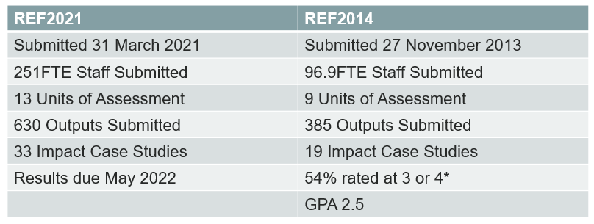
Research Excellence Framework – REF2021
Future ambition: 400FTE staff submitted to next ‘REF’
Post-submission Audit currently occurring
Future Research Assessment Programme UK (FRAP)
Sector-wide Consultation due 2022 Evolutionary ‘vs’ Radical Change?
“….the programme aims to explore possible approaches to the assessment of UK higher education research performance.
“……..simplifying and reducing the administrative burden on the HE sector.”
Notes:
1)The FRAP sector consultation is being led by the funding bodies at the request of the UK government and is expected to launch Autumn / Winter 2021. We are awaiting details, but we plan to gather staff input to the institutional consultation response and will be communicating in due course.

Slide 17
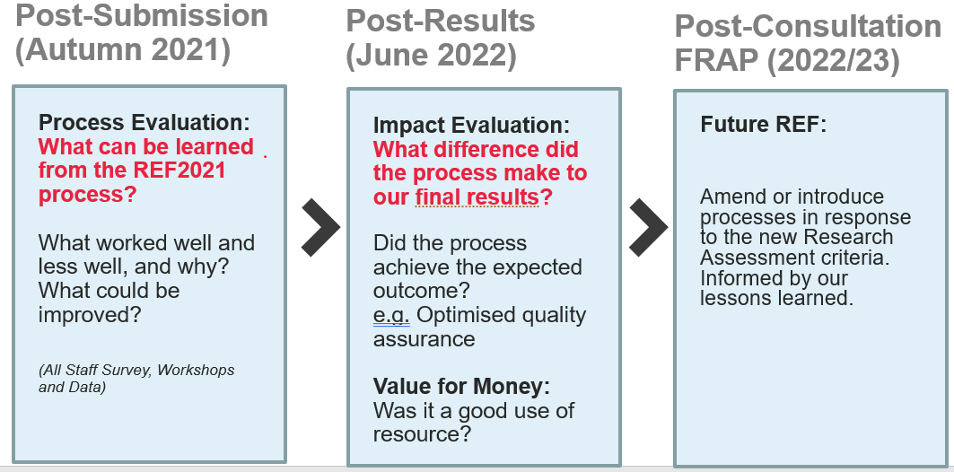
Internal ‘REF-lections’ Project
Purpose:
Assess the full REF2021 preparation process at Edinburgh Napier University
Uncover positive and negative aspects of internal processes in order to improve preparation for future ‘REF’
Outcome:
A series of recommendations, informed by University-wide input and data, to be taken forward by the University
Notes:
Our REFlection evaluation project is currently occurring to help us understand the successes and failures of our REF2021 preparations and put improved processes in place.
The project is being overseen by a steering group made up of staff at various levels and disciplines.
We conducted an all staff survey in the Summer and are in the midst of some focus group workshops to explore the key topics in order to make some process improvement recommendations in the New Year.
Following receipt of the results in May 2022, we will reflect again to ensure processes are fit for purpose in the context of tying the processes to actual outcomes/ results. Thanks to everyone who has engaged so far. And thanks to Ali and Elaine who are leading this piece of work.

Slide 18
Innovation Hub Components
A high-quality digital portal for showcasing our work, opportunities for engagement, linking our services, and routing enquiries
Operational Plans & Activities - a steering board to evaluate opportunities, oversee the development of strategic partnerships and manage key relationships
Physical presence on campuses for workshops, talks and presentations

Slide 19
Innovation Hub
Showcasing Capabilities and Opportunities to Engage
Notes:
Fund Innovation
solve your problems/challenges
Increase productivity
access our knowledge/IP
Short Course and CPD / Upskill your workforce
Train existing staff
Access new talent
Join Our Community
Be part of our Entrepreneurial Eco-system
Investment Opportunities
Opportunity for all
Innovation-led economic recovery

Slide 20
Innovation Hub Website: Get the Napier Effect
Notes:
The Napier Effect.. Working with ENU academics and listening to their stories about the impact of their research. There’s a pattern of a Negative scenario going to a positive one, a problem and delivering a solution, the before and after so we developed a core concept for the Innovation Hub website of around the ‘Napier Effect’ with a call to action to contact us and ‘Get the Napier Effect’, The site is structured around the 4 University Themes and includes core pages with Case studies showcasing our research and impact as well as how companies can engage with us to fund innovation projects, access talent and develop their workforce and / or become part of our research. innovation and enterprise community.
Talk through the 4 case studies …

Slide 21
Focus on Short courses, CPD and Consultancy
Notes:
This slide shows only CPD client - Current clients or those with a proposal in development with Edinburgh Napier University. This area is led by Georgina Gilmer and is supported by a strong team of Business Development Relationship Managers as well as members of the wider RIE team .

Slide 22
Building an Enabling Environment
Central Short Courses Website
Process Efficiencies (cradle-to-grave process)
New Course Merchant payment system (NCB CPD)
Incentive Framework
Certificates
Student records management for non-credit bearing provisions
Curriculum Management Programme (incl. CPD)
Internal Funding Competition NCB CPD

Slide 23
Focus on KTP
BDRM Team Recruited
Notes:
ENU has had a focus on increasing the portfolio of KTPs for the past couple of years. The BRDM team (led by Fiona Mason) take a proactive role in supporting academics to identify opportunities and business partners and to scope potential innovation projects with the external partners – each School has a BDRM working to support staff with business engagement and development of a pipeline of opportunities across the full range of KE modalities and funding sources which deliver benefits for our business partners through research, Innovation and entrepreneurship.

Slide 24
Focus on IP Commercialisation University Innovation Panel Process
PRE-PANEL
GATE 1 and 2
School Innovation Panel
GATE 3
Central Innovation Panel
GATE 4 Spin Out
CIP review
GATE 4 License
Spin-out company formed
License agreed
Inventor develops the opportunity with RIE
Initial opportunity review
General review of exploitation route exploitation route
CIP review
Advanced opportunity review
Up to £Xk funding
Up to £3k funding
(Gate 1)
Up to £12k funding
(Gate 2))
Pre-commercialisation phase
Commercialisation phase

Slide 25
Focus on Startups & Entrepreneurial Community Building
START-UP SUPPORT
Access to co-working space, business advice and coaching for all students, staff, and alumni. Help to develop commercial opportunities.
FREELANCERS
Freelance Academy is open to students, staff, and recent graduates.
SOCIAL SHIFTERS
Inspiring responsible entrepreneurship through co-creation and collaboration with engaged and respected partners across our community. Access to resources on the Social Shifters platform supporting mission-driven innovators to tackle social and environmental challenges.
EVENTS
Workshops, masterclasses, and other events throughout the year for BRT members and the wider university community.
NETWORKS
Our supportive community is made up of Edinburgh Napier students, staff, and alumni, entrepreneurs, and advisers.
RESOURCES
We have a suite of entrepreneurial resources to help you develop yourself, your ideas, your programmes and your business.
Notes:
Entrepreneurial community within the Innovation Hub builds on the long established track record of success in delivering entrepreneurship support and training by Bright Red Triangle . Some of the activities and services offered are listed…

Slide 26
BRT Numbers
HE-BCI Survey
600+ registered members of the BRT community
262 trading businesses
27% of all student start ups in Scotland 2016-20 (equal with UoE)
200+ student appointments this year
Gender split – 60% M / 40% F
School breakdown
TBS – 46%
SACI – 19%
SAS – 4%
SEBE – 6%
SHSC – 1%
SoC – 23%
BRT Youtube channel – 20k+ views in the last year
Notes:
Higher Education Business and Community Interaction (HE-BCI Survey)

Slide 27
Notes:
Ambitions for development of the physical footprint of the Innovation Hub
Will be working to develop Innovation Hub – Creative Tech Quarter as part of the new estates Plan
Collaborative Innovation Space
A hub which signposts and connects with other innovation spaces in Merchiston, Craiglockhart and Sighthill as well as external partners
A space to meet people, engage communities and build networks in meetings, at events, or over coffee.
A place to market ENU innovation, and connect with investors, innovators and experts.

Slide 28
Questions ?
Notes:
So to conclude. Through the Innovation Hub we want to develop a s we want to stop hiding our light under a bushel, develop confident narratives, videos and images to better showcase ENU capabilities and opportunities to engage with us. The clear messgag is that ‘ENU is Open for Business’
.. Thanks you for listening, I’ll now pass you back to ..

Slide 29
Close
Autumn 2021
Professor Nick Antonopoulos

