Slide 1
Active Learning Case Study
Dr Heather Earnshaw (School of Applied Sciences)

Slide 2
Heather Earnshaw is a lecturer on the PGDE Teacher Education programme in the School of Applied Sciences, and is a subject specialist in physics.
Overall through the course we need to look at general pedagogy (how will they teach), which topics in the physics course are most likely to be challenging for pupils (what they will teach), and classroom management.
I aim to model what the students are learning to do, building first-hand experience of how teaching can be effective or obstructive, and how this will impact on their pupils.

Slide 3
When I’m planning a session I have two plans running through my mind:
what am I doing?
what are the students doing?
And I aim for the principle that the students should be working harder than me, and as such learning to enable active learning with their pupils!

Slide 4
Varied methods:
In the sessions themselves (which are 3-hour sessions), I move between direct instruction (knowledge that I need to explain/teach), and student-led (active learning).
Sometimes I need to flex in the moment – so for example I’m explaining and it becomes apparent this is obvious, I might change to asking them to write bullet points about whatever I was teaching & then I can quickly identify whether there are any gaps, or we can just move on.
Conversely sometimes I’ve asked the students to work together on a task and it becomes apparent that I’ve overestimated their prior knowledge – in which case I’ll step in and direct teach whatever the ‘gap’ is and then (depending in the situation) step back out again). It is very responsive.

Slide 5
Structure
I think people often hear ‘active learning’ and fear it is about handing control over to the students – or that the learning space will become chaotic. For me, it is about very carefully planning where I have high control – so that students have the freedom to explore their thinking.
My sessions are very highly structured this is about ensuring a really safe and inclusive space, where everyone has a voice, everyone feels able to contribute, and no voices are able to dominate.

Slide 6
Contributions
Students often plan and share on mini-whiteboards, they are amazing for students dumping their thinking in a low-stakes scenario.
Sometimes I divide into small groups who discuss, then share to the rest of the class. I tend to put the students into different groups each week. I worried initially there would be some resistance to this – but everyone seems to be very comfortable. Perhaps there is a relief in not having to work out who to sit with, or being ‘stuck’ with the same people. And I am mindful of putting quieter people into groups where they are likely to have space to speak.

Slide 7
When moving from a group task to whole class feedback – I very deliberately don’t open it up to the whole class: I go around as many groups as we have time for, and I select who within the group I’d like to give feedback. I frame this as ‘sharing some of the key points your group discussed’. It isn’t about putting the individual on the spot – this isn’t about putting the individual on the spot, this if for them to feed back on behalf of the group.
If someone more dominant interrupts, I listen & reply to the interrupter – but then very deliberately offer the conversation back to the original speaker. I am very deliberately modelling respectful listening, and equal participation. Everyone knows their voice will be heard, everyone has space to speak. The quieter students are deliberately invited to contribute. The students who tend to dominate are given a structure within which they naturally participate more equally.

Slide 8
Key messages
I try to bear in mind that just because I’m teaching doesn’t mean there’s any learning happening.
I also know myself - I know I tend to fall back into a didactic style, so I need to plan in advance the activities I’ll use to let the students make sense of the content.
I find it enhances learning - but it also makes teaching much more fun – for me as much as for the students!

Slide 9
Lots of engagement, active discussions
When asking Qs it rotates around the room instead of hands up etc.
Student Comments:
The interspersed activities - like show me boards- was really helpful and made the class more engaging.
Use of whiteboards to demonstrate knowledge and generate discussion has been excelled active learning
Use of practicals to develop knowledge and assess class relevance has been great active learning
Hands on practical with examples

Slide 10
Example activities:

Slide 11
Plan of Activities:
1 Hour 45 mins – Vectors – 6 activities
10 min plenary
Time (in mins) | Teacher Activity | Learner activity (what the students will do)
Prior to session: -
15 mins | Respond to Feedback
I had asked for feedback on post-its at the end of the first session - so responded to it here. I thanked for the things they were positive about and spoke about how I would respond to any suggestions made.

Slide 12
Plan of Activities:
Time (in mins) | Teacher Activity
15 mins | Start with a quiz/Mini Whiteboards reviewing what we did last week - modelling a starter/retrieval activity/modelling using MWBs in this way. | N.B. last question in the quiz is deliberately jargon-y & will prove that the way I did the Standards for Provisional Registration was completely ineffective, giving them experience of the impact of ineffective teaching and how to correct this once apparent.
Dual purpose here - retrieving memory of what we covered last time - and modelling interaction: what retrieval activity might look like
I made a hash of one bit the previous week - so deliberately asked them about it here, to demonstrate that if no-one in the class can answer something it is probably a reflection on the teaching (not the learners) and the need to acknowledge that to the pupils, and to re-teach.

Slide 13
Plan of Activities:
Time (in mins) | Focus | Learner activity (what the students will do)
10 mins | How to go from course spec to plan for learning – i.e. learning to plan a lesson Course spec for vectors – N5 | This is effectively planning Learning Outcomes – what do we want out of each part of lesson? Looking at course spec – think-team – what do we need to learn? What are the ‘chunks’ of knowledge/skill? List/mind map on main Whiteboard/see slide
How do we know what we are teaching/doing? The course specifications are quite high level, so we need to unpick them.
Activity was to ask the class individually on mini-white boards (MWBs) - then we gathered that thinking to co-create a mind map on the main white board. Inevitably there will be things class hasn’t thought of - so I will input those.

Slide 14
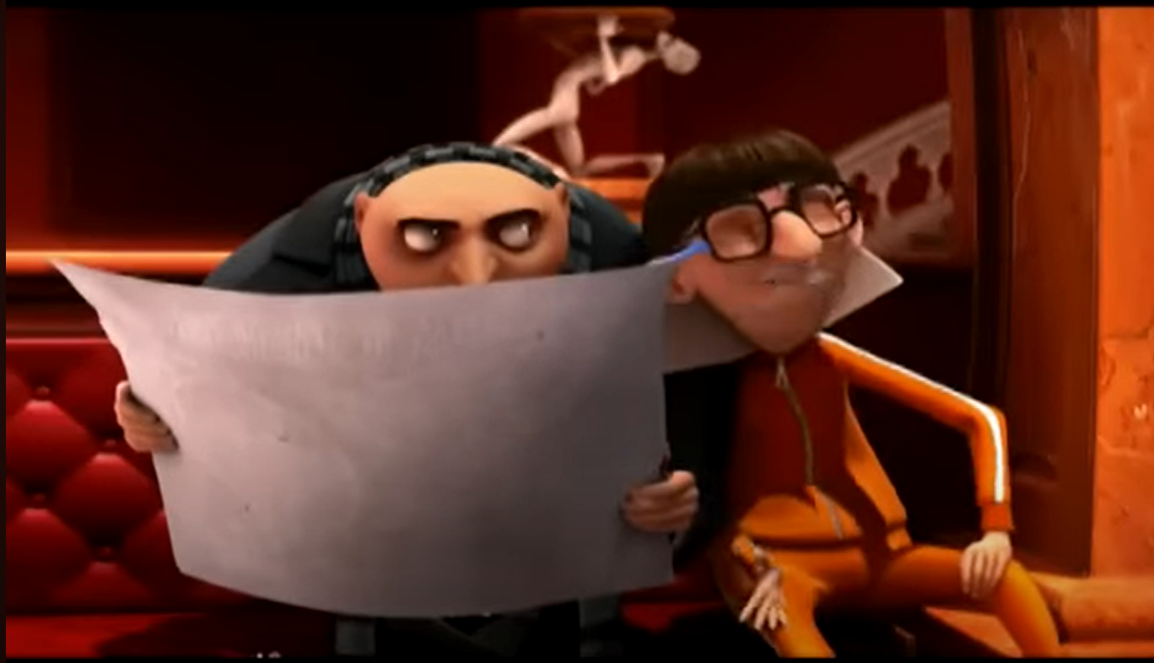
Now we know what learning we want to happen - how do we plan for it?
How do we make choices about what activity when - and thinking about how learning happens?
I will talk that through – i.e. the idea that we need to *plan* lessons carefully - there is no one right way to do it, but we need to understand why we are making the decisions we make at each choice of activity.
I would ‘direct teach’ this as an idea. Then I show them an array of activities (some practical, some paper based - all ‘active’) that could be used during the teaching of vectors at N5.
Plan of Activities:
Time (in mins) | Teacher Activity
10 mins | How to achieve each bit? Show set of resources/activities/tools: Definition & vector clip (Despicable Me) Card sort Practical – with instructions Direct teaching - scale drawing Direct teaching – calculations Past Paper Questions for idea level Physics classroom link | Need to make decisions about what activity/method at each stage. When direct teaching When practical – and why? When independent practice? When consolidating?

Slide 15
Plan of Activities:
Time (in mins) | Learner activity (what the students will do)
40 mins | Students to ‘play’ with resources and come up with suggested teaching order, how to use & why.
In pairs, gain an understanding of each of the activities - and then work out how/if/when they would use each one.

Slide 16
Then each pair takes it in turns to explain the choices they’ve made & why.
Where do the pairs agree/disagree? Are some decisions better than others?
Plan of Activities:
Time (in mins) | Class activity
20 mins | Discussion – what have they decided about learning activities & why?
Procedurally - usually I would decide which pair went first, and who I ask from each pair to speak. I do this for inclusion purposes.
Throughout the whole session I would aim to ensure that as far as possible students get the chance to work with different people, and everyone gets a chance to feed back to the whole class. (conscious that this works because of the numbers I have)

Slide 17
Plan of Activities:
Time (in mins) | Teacher Activity
10 mins | Accuracy of scale drawing – teaching precision & care (+-1mm/+-1 degree) Maths – rounding, significant figures – talking to maths dept about Pythagoras & trig How represent angles – 3 figure bearings etc.
This is most likely me direct teaching - there are some nit-picky details that students need to be clear on.
I would almost certainly talk through these things but checking to see whether class is finding this straightforward, or whether we need to spend a little more time on it.
Not generally something we need to practice in class.

Slide 18
Plan of Activities:
Time (in mins) | Class Activity
10 mins | Plenary. Mini-Whiteboards – thinking about what we’ve learned today – bullet point/discuss. Think about the explicit things – but also the things that I’ve done in my teaching that they could use – i.e. the implicit modelling of teaching – make explicit.
Making time to consolidate what we’ve thought about today.
Probably do as a think-share – i.e. give time to think & note down independently & then gather thinking together. I’d prompt as necessary.

