Slide 1


Gen AI and Assessment Toolkit
*for use with students* to be adapted as appropriate at discretion of teaching staff
Dr Louise Drumm
Dr Cameron Graham
We’d welcome anyone to get in touch with questions, comments or feedback on this guide, especially if you use it with students. L.Drumm@napier.ac.uk
C.Graham@napier.ac.uk
AI and Assessment Toolkit *for use with students* © 2024 by Louise Drumm, Cameron Graham is licensed under CC BY-NC 4.0

Slide 2
Engaging with Gen AI & Trust
[Instructions – please delete]
Start from a position of trust with your students. Be honest about your own opinions and experience of Gen AI.
Show them examples (list left) of why they might use Gen AI.
Get to know your students: discussions, introductory Padlets, Menti, inviting them to include their own experience/reflections into assessment work.
Reasons why students may use AI tools, it could be to:
  Understand the assignment task(s)
  Help structure their work
  Provide ideas to help make a start
  Re-phrase sentences or help with grammar
  Understand feedback on their work
Ask students:
  to share their understanding of AI, if and how they use AI
  why they use or do not use it
  what uses are acceptable by teaching staff (e.g. writing feedback)
AI and Assessment Toolkit *for use with students* © 2024 by Louise Drumm, Cameron Graham is licensed under CC BY-NC 4.0
Notes:
ADAPT AND/OR DELETE AS APPROPRIATE FOR YOUR STUDENTS/ MODULE/ ASSESSMENT

Slide 3
Using Gen AI in learning and assessment preparation
Artificial Intelligence (AI) tools are being developed rapidly and will continue to do so. It is likely that some of these tools may aid you when working on your learning and assessments for this module.
AI tools include:
  ChatGPT or any interface which links to ChatGPT such as apps
  Copilot (by Microsoft)
  Gemini (by Google)
  Dall-e (image generation)
  Grammarly
As AI is impacting all sectors of society including law and education as well as YOUR SUBJECT/DISCIPLINE/MODULE TOPIC (delete/add as applicable), we encourage you to become familiar with these tools if you wish.
It is likely that you will encounter AI tools in your career and personal life beyond university. Developing a critical understanding of their strengths and limitations will enhance your ability to use or evaluate these tools effectively for various purposes, while also supporting your learning and critical thinking skills.
(Drumm, 2023)
AI and Assessment Toolkit *for use with students* © 2024 by Louise Drumm, Cameron Graham is licensed under CC BY-NC 4.0
Notes:
ADAPT AND/OR DELETE AS APPROPRIATE FOR YOUR STUDENTS/ MODULE/ ASSESSMENT

Slide 4
Three Rules of Gen AI tool use
Always look at the any Gen AI-generated output with a critical eye. Ask:
  Is it factually accurate? Even though it sounds confident, it does not know anything, it is only guessing the next most likely word.
  Is it appropriate for your context and topic? How much access does the tool have to specialised knowledge?
  Does it contain any possible bias? Is this content perpetuating dominant ways of thinking and excluding marginalised or non-Western perspectives?
  Is it too generalised or superficial? Look out for bland content which says very little or promotes false balance e.g. “on the other hand…”.
Use the content to help your learning, not replace your learning. Develop the skills to critically assess AI created content; this will help you review, evaluate and improve your own work.
Always correct, refine and improve any AI created content, and remember to document what changes you make. Using Gen AI tools can provide a foundation on top of which you can start to add your original ideas and unique perspective.
(Drumm, 2023)
AI and Assessment Toolkit *for use with students* © 2024 by Louise Drumm, Cameron Graham is licensed under CC BY-NC 4.0
Notes:
ADAPT AND/OR DELETE AS APPROPRIATE FOR YOUR STUDENTS/ MODULE/ ASSESSMENT

Slide 5
Using AI in Learning: Types, Tools and Uses
Type | What it does | Example tools
Conversational AI (Chatbots) | Generates dialogues and responds to user queries | ChatGPT, Gemini, Copilot
Writing AI/Assistant | Assists with writing by editing, rephrasing, and rewriting text | Grammarly, QuillBot, Hemingway Editor
Educational AI/Applications | Provides answers to questions and completes various homework tasks | Course Hero, Photomath, Wolfram Alpha, Socratic
Voice AI/Assistant | Responds to voice commands and operates various device functions | Siri, Alexa, Google Assistant, Cortana
Adapted from Honorlock (2023) rephrased using Bard Enterprise (now Google Gemini) (16/11/23)
AI and Assessment Toolkit *for use with students* © 2024 by Louise Drumm, Cameron Graham is licensed under CC BY-NC 4.0
Notes:
ADAPT AND/OR DELETE AS APPROPRIATE FOR YOUR STUDENTS/ MODULE/ ASSESSMENT

Slide 6
Ways in which you could use AI to aid learning:
As a search engine | AI platforms will answer questions on topics you may be studying but struggle to understand. Caution: AI can sound very convincing but be very inaccurate, so always check other sources to verify accuracy.
As an ideas generator | AI platforms can quickly come up with range of ideas for what you might want to focus on in your work. Use this when you are finding it hard to get started.
As a conversational partner | Writing prompts for Gen AI is a skill. Practice refining your requests by responding with further prompts. Gen AI will learn from you and should improve and correct its answers.
As a debating partner | Ask the tool to take a role or position on a debate. Argue with it to see what ideas it and you come up with.
To suggest a submission structure | Ask the tool to provide you with a structure for your essay, report, presentation etc. Always check your assessment brief and speak to your tutor to ensure you are following the structure guidelines for the assessment.
To make suggestions to improve your communication of your ideas | This might be your grammar, spelling, phrasing etc. Many tools can help with this, but always refine the answers further and don't just copy and paste. Check that the suggestions are consistent with your own writing voice and style.
To keep you motivated | If you find yourself stalling at any point, continue a conversation with a Gen AI tool on how you are developing your thinking. It will not only help you with responses, some tools can provide friendly encouragement and affirmations which could help to keep you on track. Don't forget to document and reflect on this!
AI and Assessment Toolkit *for use with students* © 2024 by Louise Drumm, Cameron Graham is licensed under CC BY-NC 4.0
(Drumm, 2023)
Notes:
ADAPT AND/OR DELETE AS APPROPRIATE FOR YOUR STUDENTS/ MODULE/ ASSESSMENT

Slide 7
What are you permitted to do in this module with AI tools- example traffic light system
Use | Permitted? | Advice | How to acknowledge use
As a search engine | Yes | Cross reference AI output for factual accuracy in authoritative texts e.g. text books, reading lists, peer-reviewed publications | On cover sheet: “I used [tool name] on [date] with the question [insert question/prompt used] to help me [insert reason]. I used this in [section name] of this submission”
As an ideas generator/conversational partner/debating partner | Yes | Cross reference for accuracy as above AND check for bias, irrelevant or too generalised ideas. | On cover sheet: “I used [tool name] on [date] with the question [insert question/prompt used] to give me ideas, of which I used/adapted into [idea name] in this submission”
To suggest a submission structure | With caution | Consult the assessment brief first to ensure your structure follows the recommendations and meets the learning outcomes. | On cover sheet: “I used [tool name] on [date] with the question [insert question/prompt used] to get a submission structure, which I used/adapted into [part name] in this submission”
To make suggestions to improve your communication of your ideas | With caution | Always start with your own writing first to develop your own thinking. Use the AI tool to get quick feedback and use your judgement whether its advice is appropriate for your submission. Work on one paragraph at a time. | On cover sheet: “I used [tool name] on [date] with the question [insert question/prompt used] on [section name(s)/whole submission] to get feedback on my writing, which I then improved based on its advice on [spelling/grammar/vocabulary/etc.]
To generate content (example 1: not allowed) | No | Never ask an AI tool to generate parts of your submission from scratch. Do not input assessment brief or rubric into AI tools and ask it to generate your submission.
To generate content (example 2: allowed) | With caution | Always put copied-and-pasted AI content in quotations marks (in the case of text) or label other media appropriately. | On cover sheet: “AI generated content is indicated in this submission [within quotation marks/labelled] which gives the prompt used, the tool name and date used”
**Acknowledgement wording should be adapted to comply with School referencing style.
AI and Assessment Toolkit *for use with students* © 2024 by Louise Drumm, Cameron Graham is licensed under CC BY-NC 4.0
Notes:
ADAPT AND/OR DELETE AS APPROPRIATE FOR YOUR STUDENTS/ MODULE/ ASSESSMENT

Slide 8
Grammarly functionality (as of November 2024)
Grammarly has functions which may be acceptable and unacceptable for use in assessments. Note that the free and paid for versions have significant differences, such as the one highlighted below.
Free version
Paid-for 'premium' version (£10 p/m)
Corrects grammar, spelling, and punctuation mistakes
Gives suggestions for conciseness
Feedback on tone
Gives dialect options
Generate text from prompts (max 100)
Advanced grammar, spelling, and punctuation checks
Checks for consistency in spelling, punctuation and formatting
Makes improvements to flow
Rewrites full sentences and paragraphs
Suggests formatting
Enhances vocabulary
Adjusts writing tone
Generate text from prompts (max 2,000)
“Plagiarism detection” (similar to Turnitin)
Citation style formatting

Slide 9





Basic proofreading for spelling, punctuation and grammar?
No use of Grammarly permitted in this assessment
Should my students use Grammarly?
No
What kind of writing assistance is appropriate for the assessment?
Grammarly use permitted ONLY for grammar NOT style
Yes
Yes
Making suggestions to improve clarity, tone, or style?
Does the assessment map to learning outcome(s) on English language, communication or writing skills e.g. correct grammar, spelling, punctuation, clarity, word choice, style, academic voice, flow, lack of mistakes?
No
Grammarly use permitted for grammar/style BUT NOT FOR rewriting
Yes
Grammarly use permitted EXCEPT for generating new text.
Suggesting paraphrasing or rewriting sentences?
Available in paid-for Grammarly only
No
Yes
Yes
Any use of Grammarly (free or premium) use is permitted
Would prompting Grammarly to write a first draft compromise meeting learning outcome(s)?
No
No
Louise Drumm 2024 licensed under CC BY-NC 4.0

Slide 10
Example: Am I allowed use Grammarly for this assessment? (for students)
Am I allowed to use Grammarly for feedback on my writing to improve grammar, spelling, punctuation?
Grammarly use permitted for grammar
YES
Grammarly use permitted to improve your writing style
Am I allowed use Grammarly for suggestions on improving style, tone and flow?
YES
Yes, as long as you only use your own ideas and Grammarly does not add anything new
Am I allowed use Grammarly for paraphrasing or rewriting my sentences?
YES, but...
You can only use Grammarly to improving your existing work, not to generate new text or content
Can I use Grammarly to write a first draft?
NO
Notes:
Adapt as appropriate

Slide 11
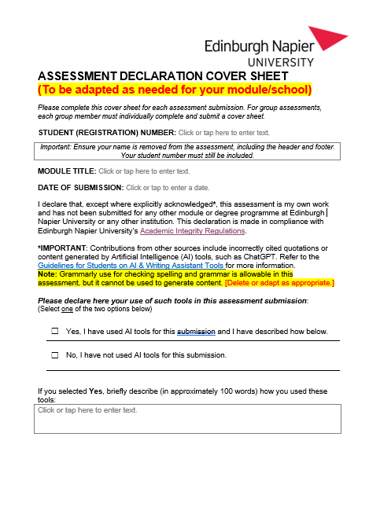
Appendices
Assessment Cover Sheet (to be adapted)
  Checkbox on AI Use
  Statement invited on AI Use and/or reflection on its helpfulness
AI and Assessment Toolkit *for use with students* © 2024 by Louise Drumm, Cameron Graham is licensed under CC BY-NC 4.0
Notes:
ADAPT AND/OR DELETE AS APPROPRIATE FOR YOUR STUDENTS/ MODULE/ ASSESSMENT

Slide 12
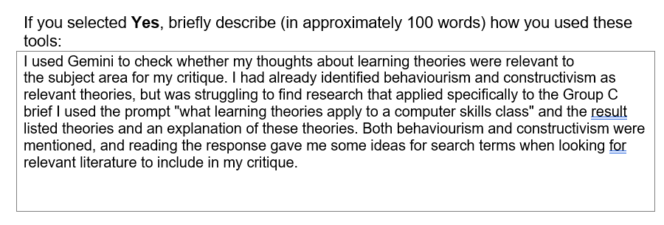
Appendices
Assessment Cover Sheet – possible responses
AI and Assessment Toolkit *for use with students* © 2024 by Louise Drumm, Cameron Graham is licensed under CC BY-NC 4.0
Notes:
ADAPT AND/OR DELETE AS APPROPRIATE FOR YOUR STUDENTS/ MODULE/ ASSESSMENT

Slide 13
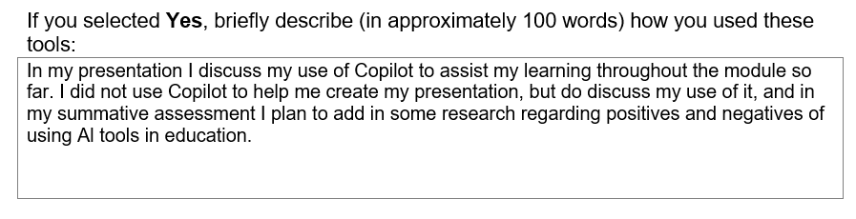
Appendices
Assessment Cover Sheet – possible responses
AI and Assessment Toolkit *for use with students* © 2024 by Louise Drumm, Cameron Graham is licensed under CC BY-NC 4.0
Notes:
ADAPT AND/OR DELETE AS APPROPRIATE FOR YOUR STUDENTS/ MODULE/ ASSESSMENT

Slide 14
Links
My.Napier Artificial Intelligence Tools and your learning (for students)
DLTE Artificial Intelligence and Learning Teaching and Assessment at ENU (for staff)
AI and Assessment Toolkit *for use with students* © 2024 by Louise Drumm, Cameron Graham is licensed under CC BY-NC 4.0

