Slide 1
School of Applied Science Enhanced PDT Model
Dr Alex McIntyre, Dr Colin McGill, Dr Christine Haddow, Dr Susan Meldrum, & Dr Margarida Dias Scoon
DLTE Student consultants: Rhiannon Airley, Alessandra Bossoni

Slide 2
School of Applied Science Enhanced PDT Model
SAS Student Retention Plan
Tutoring Matters - Student belonging and mattering: the impact on academic achievement. UKAT Webinair
Claire Zawada – Birmingham City University
AHEA - What Works student retention and success
Phase 1 - Building student engagement and belonging in HE (Thomas, 2012)
Phase 2 - Supporting Student Success Strategies (Thomas et al., 2017)

Slide 3
School of Applied Science Enhanced PDT Model
Year 1 cohort 2023-24
Pre-arrival PDT email - early engagement
PDT Induction workshop – relationships & resources
PDT evaluation – Belonging, Mattering, & Napier
PDT Focus Groups – 2024-25
PDT Infographics – Tutor & Student facing

Slide 4
School of Applied Science Enhanced PDT Model
Year 1 cohort 2023-24
Students with offer appointed PDT tutor
Pre-arrival personal email introduction
Invitation to PDT Induction or meeting
Students knew they were expected
Students knew how to contact PDT tutor

Slide 5
School of Applied Science Enhanced PDT Model
Year 1 cohort 2023-24
PDT Induction workshop
DLTE Collaboration
Navigate university resources
Connect with PDT tutor
Build community with peers

Slide 6
School of Applied Science Enhanced PDT Model Evaluation (n=138)
Pre-arrival PDT email
Higher Belongingness scores, p.047
Knowing how to contact their PDT tutor
Greater Mattering - Importance, p.008
Belonging was poorer for students
Not offered a meeting, p.001, and
Not offered a workshop, p<.05
Belonging (Yorke, 2016) and Mattering (Elliot et al., 2004)

Slide 7
SAS Enhanced PDT Induction Evaluation (n=138)
Easy to connect with peers (69.1%)
Belonging, p<.001; Mattering Awareness, p.006
Easy to navigate campus resources (78.9%)
Belonging, p<.005; Mattering Reliance, p.007
Easy to navigate myNapier resources (78.9%)
Belonging, p.014; Mattering Awareness, p.001
Belonging (Yorke, 2016) and Mattering (Elliot et al., 2004)

Slide 8
School of Applied Science Enhanced PDT Model Phase II – Focus Groups
Year 1 cohort 2024-25
Students will be appointed a PDT tutor
Pre-arrival personal email introduction
Invitation to PDT Induction or meeting
Students knew they were expected
Students knew how to contact PDT tutor

Slide 9
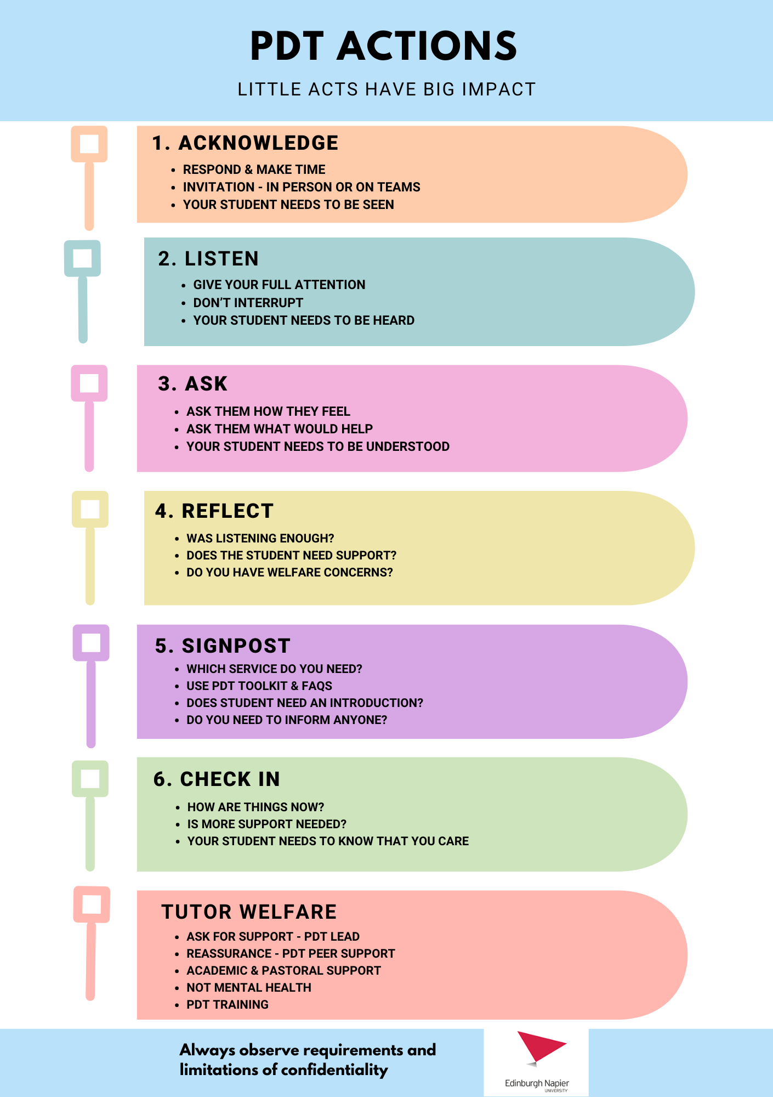
School of Applied Science Enhanced PDT Model Tutor Messaging

