Slide 1
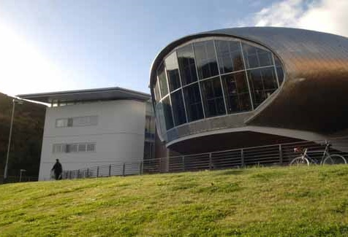
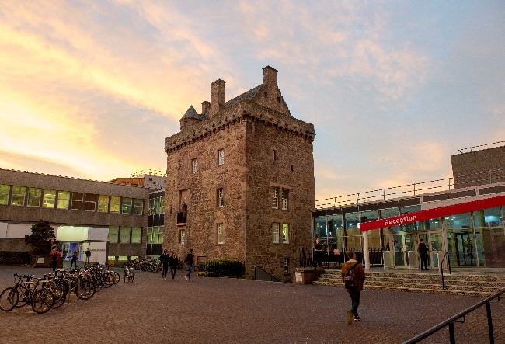
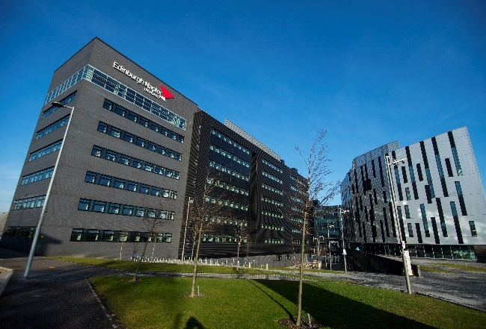
Health, Safety & Fire Student Induction
Health & Safety Team | Edinburgh Napier University
Student Induction v1.0 2024-04

Slide 2
Student Health & Safety
Edinburgh Napier University has a legal duty to ensure the health, safety and welfare of all Edinburgh Napier University students
Management of Health and Safety at Work:- Edinburgh Napier University has a legal duty to carry out suitable and sufficient risk assessments
covers all activities
you must follow them

Slide 3
Health & Safety Team
To provide information, training and advice on all aspects of health, safety and welfare
Monitor fire precautions and procedures
Accident/incident investigations, reports, recommendations and statistics
Advise on the implementation and compliance of all relevant health and safety legislation

Slide 4
Your Health & Safety Responsibilities
Comply with all health and safety policies and procedures
Follow safe systems of work
Use machinery, materials, Personal Protective Equipment etc. as instructed
Participate in health and safety training
Report all hazards and risks
Work safely

Slide 5
First Aid Arrangements
Know and understand the University’s first aid arrangements
A university trained first aider can be contacted via:
Security control room 0131 455 4444
Campus reception
SafeZone app
If you have an accident/incident/dangerous occurrence/near miss whilst on university premises, you must report it to a member of staff. (They will complete a Health & Safety incident reporting form).

Slide 6
Control of Substances Hazardous to Health (COSHH)
COSHH regulations are designed to protect you from hazardous substances used at work
Follow the University’s instructions and use control measures properly
Read all hazard warning signs and instructions on containers - they should tell you if a substance is toxic or causes burns etc.
Before you use a substance, find out what to do if it spills on your skin or clothes
If in doubt, stop and contact your lecturer

Slide 7
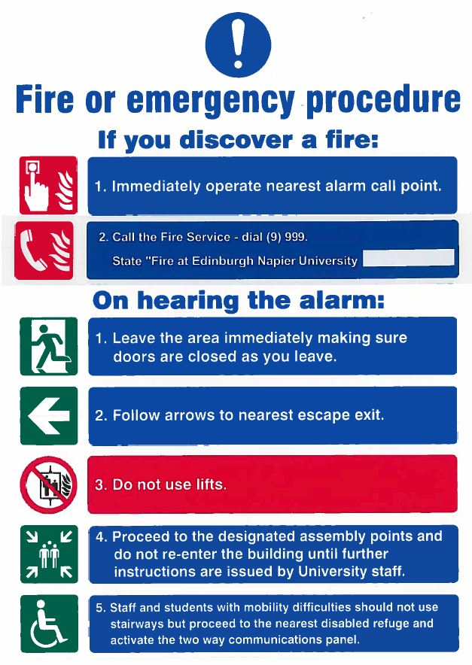
Fire and Emergency Procedures
Please read the blue and white notices provided throughout the University
These give details of the University’s fire and emergency procedures

Slide 8
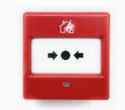
Fire Procedures
On discovering a fire:
Raise the alarm
Immediately operate the nearest break glass call point
Call the Fire Service: dial (9) 999 and state "Fire at Edinburgh Napier University..." and give campus address
Evacuate the building
Use the nearest available exit
Do not use lifts

Slide 9
Fire Procedures
On hearing the alarm:
Evacuate the building
Use the nearest available exit
Never use the lift
Follow instructions given by Fire Wardens and staff
Assemble at the designated assembly points for the campus
Keep access clear for emergency services
Do not re-enter the building until authorisation given by the Senior Fire Co-ordinator

Slide 10
Assembly Points
Craiglockhart
A: Service road opposite the visitors' car park
B: Disabled car park at north of building
C: End of roadway at south-west of building adjacent to large decked area
Sighthill
A: Area adjacent to main campus entrance
B: South-west corner of car park, adjacent to energy centre
C: East car park
Merchiston
A: Pillar in main courtyard at front of building
B: West car park
C: East car park behind refectory
Merchiston Avenue
A: To right of main entrance

Slide 11
Personal Emergency Evacuation Plans
All students who may need assistance to evacuate the building in an emergency should arrange a Personal Emergency Evacuation Plan (PEEP) through Wellbeing & Inclusion

Slide 12
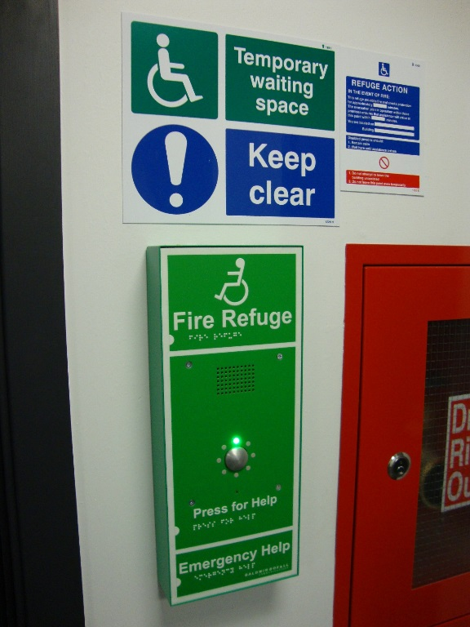
Fire Procedures: Temporary Waiting Spaces
Temporary waiting spaces are provided at:
Craiglockhart Campus
Merchiston Campus
Sighthill Campus
Temporary waiting spaces provide safety for at least 30 minutes until assistance arrives

Slide 13
Temporary Waiting Spaces: Craiglockhart, Merchiston & Sighthill
Fitted with two-way communication systems
When the fire alarm sounds proceed to your nearest temporary waiting space
Press the “Press for Help” button once to initiate a call (do not continue to press or hold during a call)
This will also indicate at the fire panel that someone is in the specified temporary waiting space
The call will be answered - if you get no reply, do not panic - your call has been logged with the 24 hour Security Control office
Remain in the temporary waiting space until assistance arrives

Slide 14
Staying Safe
Slips, trips and falls are still the major cause of accidents
To prevent them:
don’t leave things lying around
clean up spills straight away
keep work areas/walkways/corridors tidy and clear
Report any hazards immediately to your lecturer/supervisor

Slide 15
Staying Safe
Only use equipment after you have been trained and given permission to use it - follow exactly the safe system of work
Tell your supervisor immediately if you think the equipment is unsafe
Report any damaged electrical equipment including cables and extension leads
Lifting and carrying - take time and care to lift and carry items correctly

Slide 16
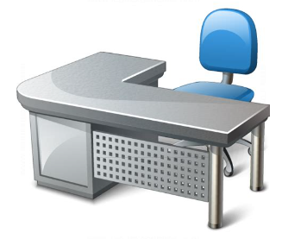
Your Work Environment
Tips for improving your work environment
Adjust your chair and desk setup to find the most comfortable position for your work. As a broad guide, your arms should be approximately horizontal and your eyes at the same height as the top of the monitor casing.
Make sure there is enough space underneath your desk to move your legs freely. Move any obstacles such as boxes or equipment.
Avoid excess pressure on the backs of your legs and knees. A footrest, particularly for smaller users, may be helpful.
Arrange your desk and screen so that bright lights are not reflected in the screen. You shouldn't be directly facing windows or bright lights. Adjust curtains and blinds to prevent unwanted light.

Slide 17
Out on Placement
Ensure you are aware of their emergency evacuation procedures and accident reporting system
Report any health and safety concerns to your supervisor
Follow their health and safety procedures

Slide 18
Health & Safety Team
Sean Hughes, Interim Head of Health & Safety
David Conner, Health & Safety Manager
Kevin Weir, Fire Safety Adviser (p/t Mon-Wed)
Ruth Thin, Health & Safety Co-ordinator
health&safetyoffice@napier.ac.uk

Slide 19
For more information:
Visit My Napier and download a copy of the Student Safety Guide
Have a safe and healthy time at Edinburgh Napier !
Health & Safety Team | Edinburgh Napier University

