Slide 1
University Information Audit 2014
Improving information and records management as part of the University’s continuous improvement approach (Strategy 2020).

Slide 2
Information Asset
Strategy 2020
Risk

Slide 3
Introduction
Information is a business asset…
As a University we are in the information business – we ‘process’ massive amounts of data and information every day.
It is the life-blood of the institution…essential to our continuing functioning. Information is effectively one of the biggest assets of the University and there are a variety of risks associated with its management.
Every business process is supported by information, however the information and its management are often seen as secondary to the process.
Notes:
‘Process’ includes actions such as: receiving, creating, storing or retaining, using, re-using, updating, consulting, imparting, sharing and disposing of information.
Data and information includes customer interactions, personal data, internal and external correspondence (emails, web enquiries, letters, social media, etc.), electronic files and system information, paper and hard copy documents and records, our ‘product’ (teaching/learning materials, feedback), confidential and other corporate data.

Slide 4
Risks
Fines of up to £500K or potentially a % of the University’s turnover in future
Keeping information longer than permitted
Loss of information
Difficulties finding or retrieving information
Breach of legislation
Unlawful disclosure of personal or confidential information
Destroying information too soon
Impact on individuals affected
Notes:
The risks which have to be considered when managing information are diverse – from disclosure of personal data in breach of the Data Protection Act (DPA) or retention of information beyond the time limits allowed in breach of the DPA and other legislation, to a loss of information which disrupts business operations or difficulties finding information which costs time, effort and money to retrieve.
This can have a damaging impact on the business, causing reputational damage, financial loss, business inefficiency, etc. and it is therefore critical that the University puts measures in place to mitigate against these risks.

Slide 5
Why an Audit?
The Information Audit is a risk mitigation exercise and quality improvement process. By understanding what information the University holds and how this is being processed, we can assess where there are areas of risk and put procedures in place for improving the management (and security) of our information.

Slide 6
Why now?
Strategy 2020
7 years since the last Information Audit
Records Management Policy and Strategy urgently require revision.
Departmental records management procedures and documentation need establishing/updating
New requirement for self reporting of DPA breaches to the ICO and the introduction of stricter sanctions and heavier penalties for breaches – possibly a % of turnover
Recent departmental restructuring/office moves
ISO27001:2013 – more stringent requirements in the new standard and frequent audits
Preparation for being brought into scope for National Records of Scotland (Public Records (Scotland) Act)

Slide 7
Strategy 2020
Build Innovation, Enterprise and Citizenship
Adopt a continuous improvement/enhancement approach in all that we do
Maximise the value of our [information] assets
Information and records are received and created by University staff members and representatives to facilitate and support business processes – they are inputs and outputs of the University’s activities. Ensuring that our information assets are managed correctly corresponds directly with the objectives of Strategy 2020, namely improving the efficiency of business processes.
For more information on how the Information Audit will contribute to Strategy 2020 please see: http://staff.napier.ac.uk/services/secretary/governance/Pages/InfoAudit.aspx

Slide 8
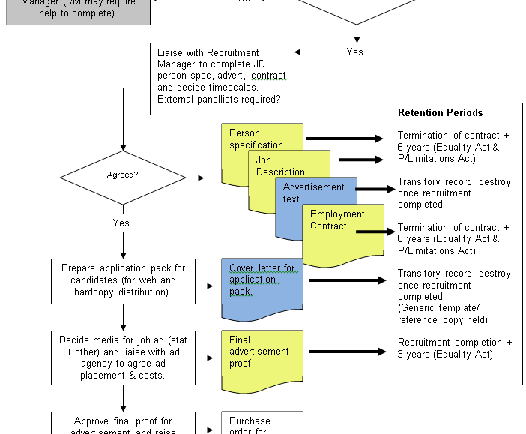
Business process : information relationship (Generic HR recruitment process example)

Slide 9
Information Audit Aims and Objectives
Ensure legislative compliance
Understand the current situation with regards to information processing/storage in order to:
Assess risk and mitigate where the likelihood of a breach of legislation/regulation is higher
Develop an Information Asset Register (IAR) and develop/update Records Retention Schedules (RRS)- both of which are compliance assurance tools. **Records Retention Schedules are particularly important in that they set out the University’s policy for retaining and destroying records, ensuring we are not subject to action for early destruction and undue retention. These give staff confidence that they are retaining information for the correct length of time**.
Inform the development of a new Records Management Strategy and Records Management Policy, and other policies and procedures to assist with the continual improvement of the management of University information and records.
Generally raise awareness of the importance of good information and records management practices, and the requirements and individuals’ responsibilities in this regard

Slide 10
Documented outcomes
Information asset register…linked to…
Comprehensive Records (and Information) Retention Schedules (POLICY document to defend the University’s actions regarding retention of information, if challenged)
Business process procedures…linked to…
Information and records management procedures (including filing arrangements and naming conventions)

Slide 11
Opportunities
To improve the processes used to manage corporate information across the University in line with Strategy 2020, resulting in efficient business processes supported by efficiently managed information and records
To ensure your departmental business procedure documents are up to date (if they aren’t already)
Provide staff members with the tools, knowledge and confidence to manage all the information that they process, including unstructured data (shared drives, SharePoint, email), and transitory records or supporting information which may not necessarily be dealt with in a Records Retention Schedule.

Slide 12
Benefits
University:
Business efficiencies
Risk mitigation
Staff members:
CONFIDENCE! Departmental RM procedures to follow for correct and consistent practices
The right information available to the right people at the right time
Assurance that information is reliable, secure, authentic, and can be easily found and retrieved for use and re-use
Customers:
Confidence that their data is safe and secure with us

Slide 13
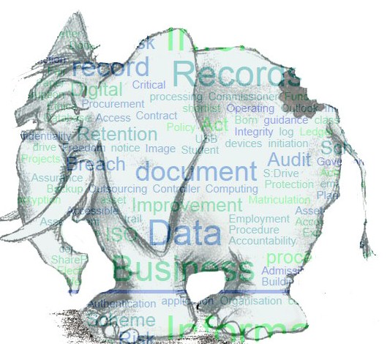
How do you eat an (information) elephant…?
…one business process at a time

Slide 14
The Audit Process
Appraise
Information Audit gathers information
Evaluate
Governance Services collate and assess information
Gap Analysis
Governance Services work with depts. to identify areas of risk/ for improvement
Improve
Collaborate to improve information & records management procedures.
Initial processes for Audit identified

Slide 15
Approach
There are 3 stages to the Audit
1) Managers Questionnaire and identification of top 3 business processes supported by high risk information
2) Audit Spreadsheet for completion by Records Management Co-ordinators in co-operation with appropriate members of staff
3) All Staff Questionnaire
…the plan is to make the audit a manageable task…

Slide 16
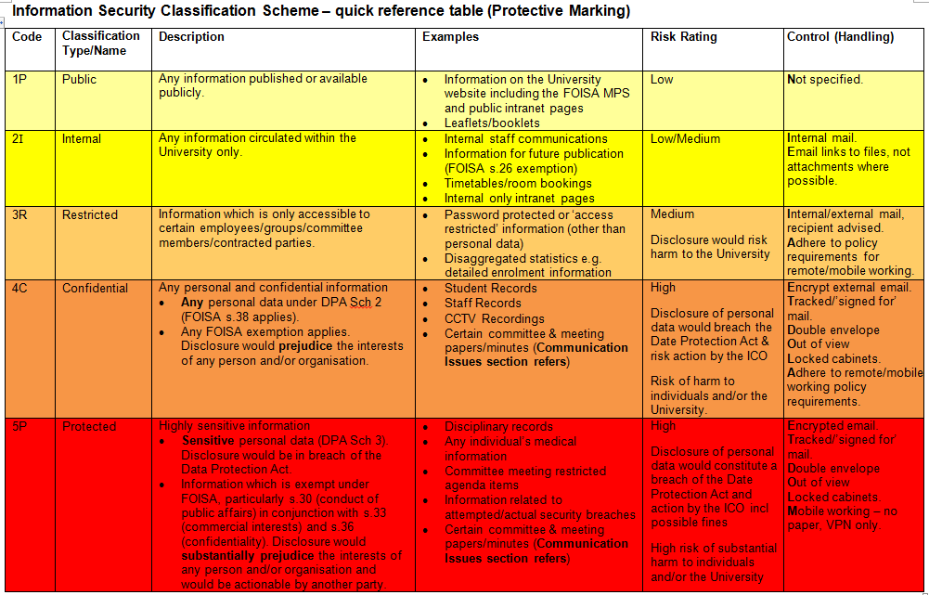
What information is high risk?

Slide 17
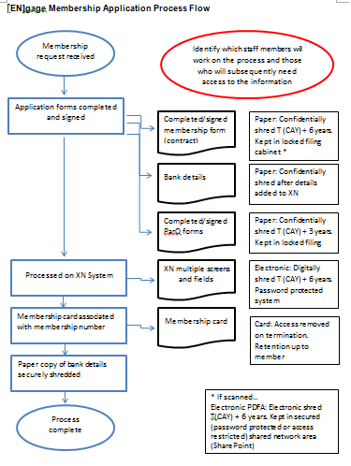
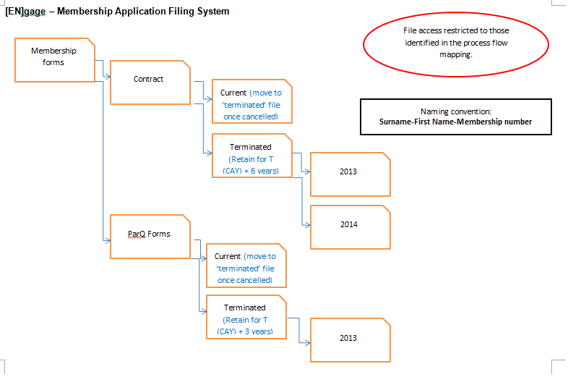
Outcome examples
Work (process) procedure
Information Asset Register
Records (& info) Retention Schedule
File Plan (manual & electronic) and access permissions
Naming conventions
Annual disposal schedule

Slide 18
Finally…
If you have any process improvement work being done as part of the ‘Improving Operational Processes and Procedures’ project it would be a good opportunity to conduct Information Audit work at the same time.
Please raise awareness of the Information Audit within your teams and identify members to undertake this work and liaise with Governance Services.
Please complete the ‘Manager’s Questionnaire’

Slide 19
Further Information
Please contact Governance Services, either
Diana Watt
Governance Officer (Records Manager)
D.Watt@napier.ac.uk (extension 6257)
or
Helen Mizen
Governance Officer (Data Protection & Legal)
H.Mizen@napier.ac.uk (extension 6359)
or check the intranet for further information and updates:
http://staff.napier.ac.uk/services/secretary/governance/Pages/InfoAudit.aspx

