Slide 1
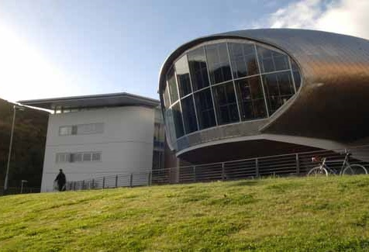
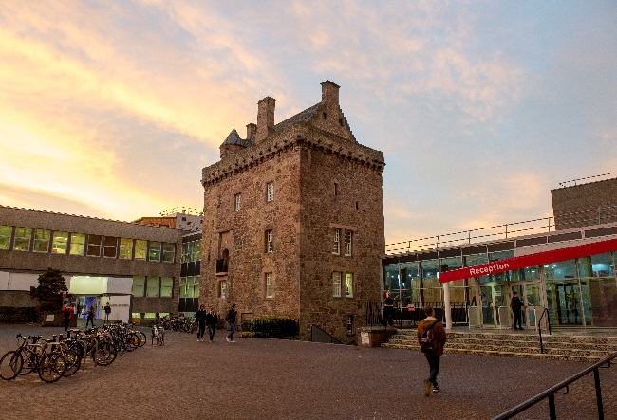
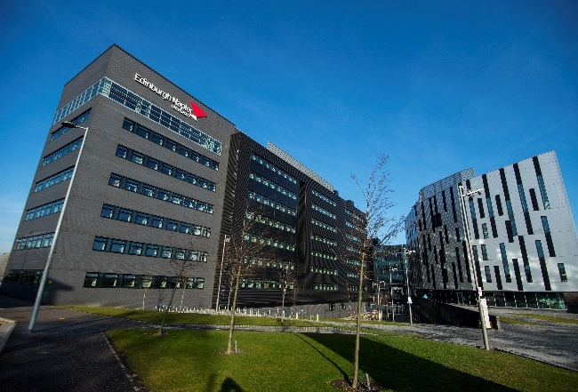
Health, Safety & Fire Staff (Associates) Induction
Health & Safety Team | health&safetyoffice@napier.ac.uk
Staff (Associates) Induction v1.0 2024-04

Slide 2
Health & Safety Team
Provide information, training and advice on all aspects of health, safety and welfare
Monitor fire precautions and procedures
Accident/incident investigations, reports, recommendations and statistics
Advise on the implementation and compliance of all relevant health and safety legislation

Slide 3
Your Responsibilities
Comply with all health and safety policies and procedures
Follow safe systems of work
Use machinery, materials, Personal Protective Equipment etc. as instructed
Participate in health and safety training
Report all hazards and risks
Work safely

Slide 4
Accidents/Incidents
In the event of any illness or injury on campus, contact a trained First Aider via the Security Control Room (0131 455 4444 or internal ext. 4444), the Campus Reception​ or the SafeZone app
All incidents should be reported using the Health & Safety Incident Report Form (available on the H&S website)
Policy: Accident, Dangerous Occurrence, Disease & Near Miss Policy

Slide 5
Occupational Health
Occupational Health Service is managed by the People Team through an external provider
Contact HumanResources@napier.ac.uk

Slide 6
Stay Safe
Slips, trips and falls are still the major cause of accidents
To prevent them:
don’t leave things lying around
clean up spills straight away
keep work areas / walkways / corridors tidy and clear
If you spot a hazard, report it immediately to your line manager
Report any damaged electrical equipment including cables and extension leads
Policy: Housekeeping Policy

Slide 7
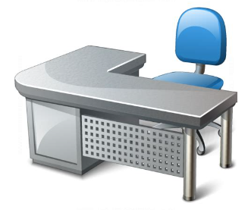
Your Work Environment
Tips for improving your work environment
Adjust your chair and desk setup to find the most comfortable position for your work. As a broad guide, your arms should be approximately horizontal and your eyes at the same height as the top of the monitor casing.
Make sure there is enough space underneath your desk to move your legs freely. Move any obstacles such as boxes or equipment.
Avoid excess pressure on the backs of your legs and knees. A footrest, particularly for smaller users, may be helpful.
Arrange your desk and screen so that bright lights are not reflected in the screen. You shouldn't be directly facing windows or bright lights. Adjust curtains and blinds to prevent unwanted light.
Policy: Display Screen Equipment (DSE) Policy

Slide 8
Manual Handling
Do size up the job first - if it is too big to carry alone get help from a colleague or lifting equipment
Do use mechanical devices such as hoists, cranes, trolleys or forklift trucks wherever possible
Do wear protective clothing if necessary
Don’t carry so much that you cannot see where you are going
Don’t jerk at a heavy load - this is more likely to strain an arm, shoulder or back than shift the load
Don’t keep trying to lift a load which you know is too heavy for you
Don’t change grip while carrying - rest the load in a firm support then change
Policy: Manual Handling Policy

Slide 9
Control of Substances Hazardous to Health (COSHH)
COSHH regulations are designed to protect you from hazardous substances used at work
Follow the University’s instructions and use control measures properly
Read all hazard warning signs and instructions on containers - they should tell you if a substance is toxic or causes burns etc.
Before you use a substance, find out what to do if it spills on your skin or clothes
If in doubt, stop and contact your line manager
Policies: Control of Substances Hazardous to Health (COSHH) Policy
Hazardous Substances (Safe Purchase, Storage, Transportation and Disposal) Policy

Slide 10
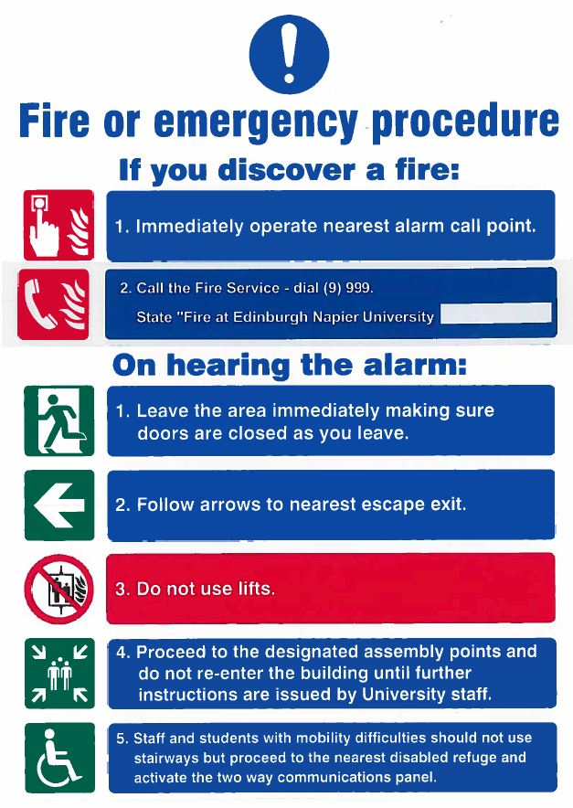
Fire or Emergency Procedures
Please read the blue and white notices provided throughout the University
These give details of the University’s fire and emergency procedures

Slide 11
On discovering a fire:
Raise the alarm
Immediately operate the nearest break glass alarm call point
Call the Fire Service: dial (9) 999 and state "Fire at Edinburgh Napier University..." and give campus address
On hearing the alarm:
Evacuate the building
Use the nearest available exit – never use the lift
Assemble at the designated assembly point
Keep access routes clear for emergency services
Do not re-enter the building until authorisation given by Senior Fire Co-ordinator / Fire Officer in charge

Slide 12
Assembly points
Craiglockhart
A: Service road opposite the visitors' car park
B: Disabled car park at north of building
C: End of roadway at south-west of building adjacent to large decked area
Sighthill
A: Area adjacent to main campus entrance
B: South-west corner of car park, adjacent to energy centre
C: East car park
Merchiston
A: Pillar in main courtyard at front of building
B: West car park
C: East car park behind refectory
Merchiston Avenue
A: To right of main entrance

Slide 13
PEEPs (Personal Emergency Evacuation Plans)
All staff who may need assistance in an emergency evacuation should have a Personal Emergency Evacuation Plan (PEEP) drawn up - the relevant School or Service should contact the Health & Safety Team in the first instance
All students who may need assistance in an emergency evacuation should arrange a Personal Emergency Evacuation Plan (PEEP) through their Disability Contact / Wellbeing & Inclusion

Slide 14
Temporary Waiting Spaces
Temporary Waiting Spaces (TWS) are provided at:
Sighthill
Merchiston
Craiglockhart
Temporary Waiting Spaces provide safety for at least 30 minutes until assistance arrives
Location and further information on Temporary Waiting Spaces available on the Health & Safety website

Slide 15
Temporary Waiting Spaces– Sighthill, Craiglockhart & Merchiston
Fitted with two-way communication systems
When the fire alarm sounds proceed to your nearest TWS
Press the “Press for Help” button once to initiate a call (do not continue to press or hold during a call)
This will also indicate at the fire panel that someone is in the specified TWS
The call will be answered - if you get no reply, do not panic, your call has been logged with the 24 hour Security Control office
Remain in the TWS until assistance arrives

Slide 16
Campuses without TWS
Anyone with mobility difficulties should not use stairways or lifts
They should proceed to the nearest place of safety
Their whereabouts should be reported to the security control room on ext. 4444 (0131 455 4444) or via the SafeZone app

Slide 17
Useful contacts
Health & Safety Office health&safetyoffice@napier.ac.uk
Health & Safety website
Facilities Service Desk ext 5000 FacilitiesServiceDesk@napier.ac.uk
Occupational Health contact the People Team HumanResources@napier.ac.uk
SafeZone app
Download the app:
Apple: SafeZone on the App Store
Android: SafeZone on Google P​lay ​
Health & Safety face to face training – HR Connect / Learning

Slide 18
Health & Safety Team
Sean Hughes, Interim Head of Health & Safety
David Conner, Health & Safety Manager
Kevin Weir, Fire Safety Adviser (p/t Mon – Wed)
Ruth Thin, Health & Safety Co-ordinator
Health & Safety Office
6.B.22 Sighthill Campus
health&safetyoffice@napier.ac.uk

